Slide 1




Changing the Conversation on Adult Vaccination”: Good Practice in Development of Effective Messages.
Lois Privor-Dumm
Director Adult Vaccines
Senior Advisor, Policy, Advocacy & Communications
Picture credit: National Institute on Aging

Slide 2
A few principles underlying effective communication
Understand the inequities and that all communities are not monolithic
Listen to and engage the community
Evidence and transparency must form the basis of messaging
Test and iterate as information and context changes

Slide 3
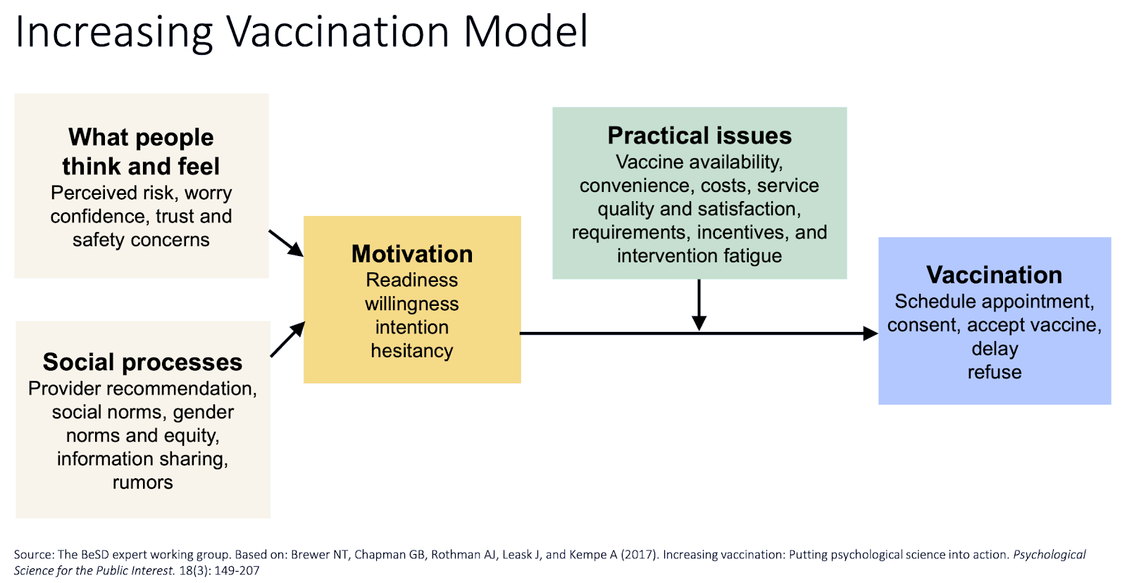
Increasing immunization rates starts with understanding behavior

Slide 4
Why?
Listening tells us a lot

Slide 5
Factors influencing COVID vaccine decisions
“I do not wish to be a guinea pig”
“I will not trust it unless I see other people have it for at least 2 years and they have no problems… It took years to get vaccine for other stuff. I will not trust it right now.”
Specific concerns mentioned | Lack of trust in vaccines or safety concerns (N=108)
Composition of vaccine | 6 (6%)
Waiting until others get vaccinated | 27 (25%)
Concerns of manufacturing/rushed development | 31 (29%)
Side effects | 21 (19%)
Medical mistrust | 9 (8%)
Trump | 4 (4%)
General vaccine distrust | 14 (13%)
“Donald Trump rushed the vaccine, and I do not trust it.”
“How in the world in one year you have a vaccine [for COVID-19] but you don't have a cure for cancer or the common cold.”
“I don't trust it because I do not know much about it.”
“I just heard about people in the UK having bad reactions to the vaccine. That is concerning.”
Concerns are not mutually exclusive; multiple may have been mentioned.
“Every time I think about the vaccine, I think about the Tuskegee Study, so I am not getting it.”
“I do not trust the government and history of past tests on African Americans and military personnel.”
Notes:
Concerns includes: 'Concerns about COVID illness (fear of COVID)',"I don't need the vaccine",'My age’, 'My health history and risk of severe illness and complications (e.g., existing medical conditions)','My race/ethnicity’, 'My risk of being exposed to COVID-19','The number of people still getting sick and/or dying from COVID-19’
Lack of trust in vaccine or concerns includes: 'Lack of personal knowledge around COVID vaccine','No Trust/Vaccine Safety','Previous vaccine experience’
Opinion or approval from trusted person include: "If trusted agency/messager approves and/or receives vaccine","The opinions of my family members, friends, and community leaders“
Other inludes: 'Convenience (e.g., easily accessible and available)','Doing something that benefits my community (e.g., protecting others)’, 'God','If the vaccine is covered by my insurance','None, I do not intend to get a COVID-19 vaccine','Other'

Slide 6
Many reasons for older adults not getting vaccines
Hesitancy
Trust in vaccine
Trust in govt, health system
Access
Transportation
Internet access, savvy
Information
Older adults may not see the need,view vaccines as something for children
or not get them if heath provider doesn’t recommend

Slide 7
Message Development

Slide 8
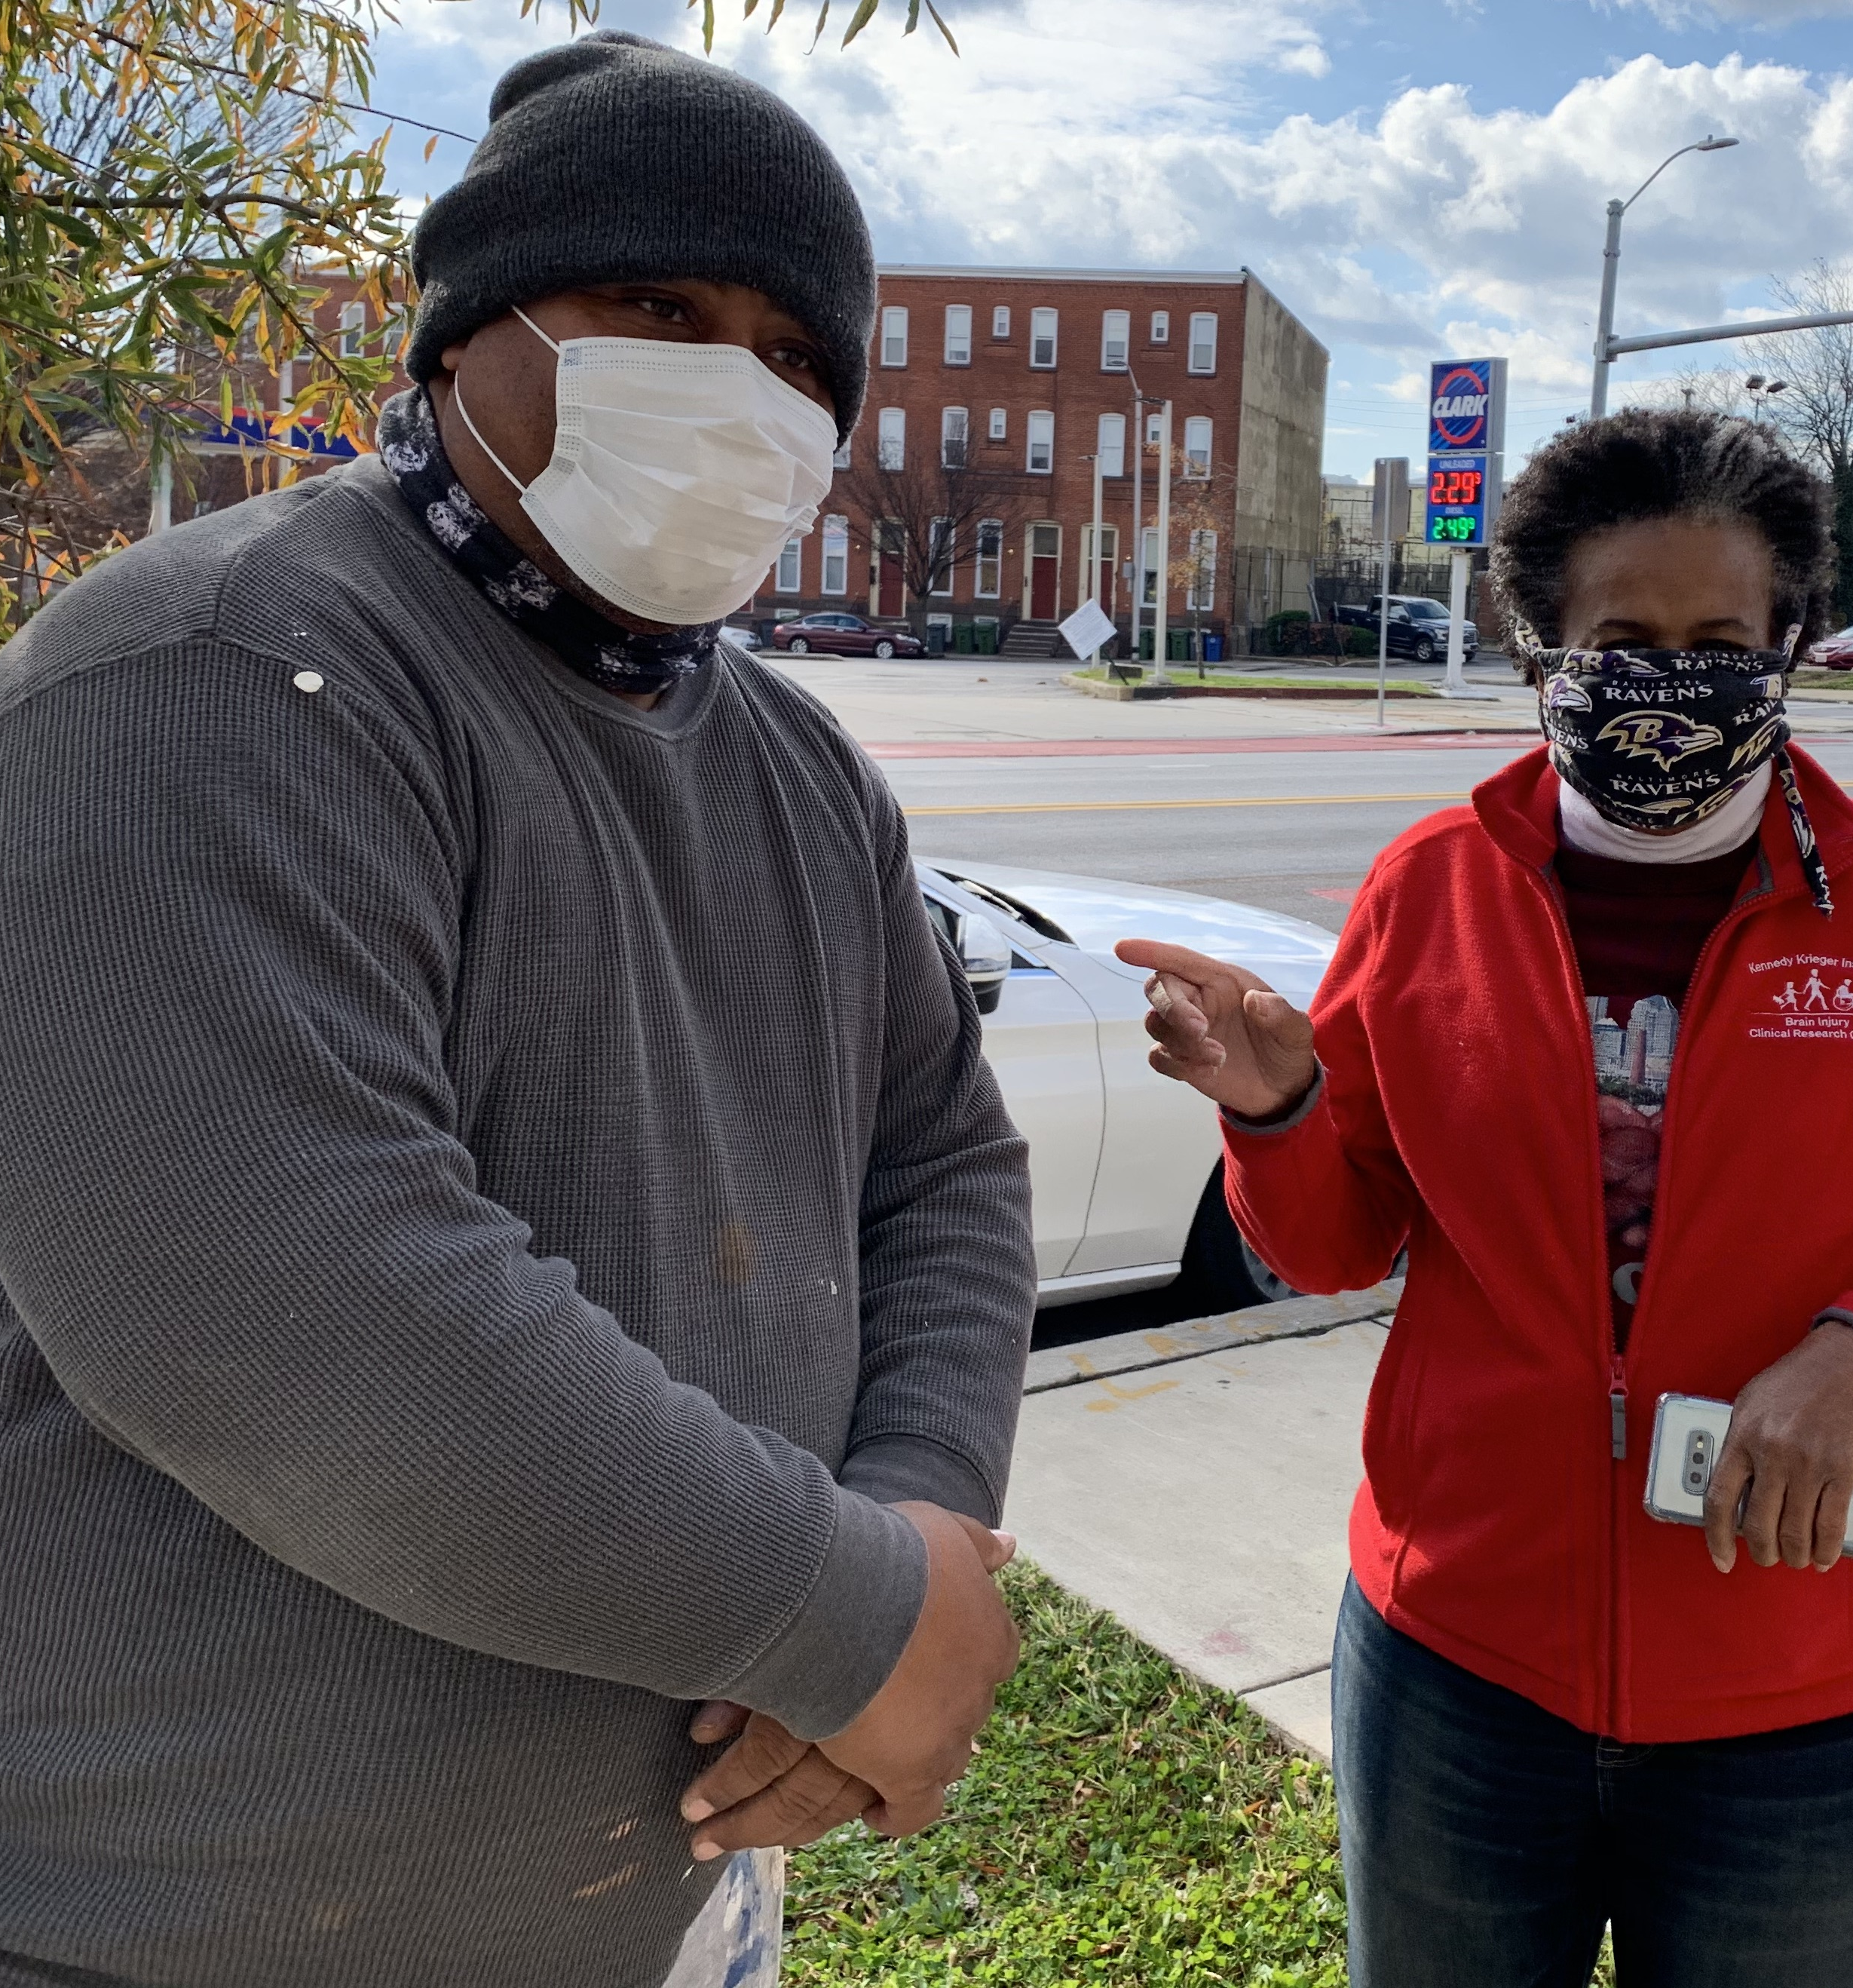






VALUE Baltimore
Vaccine Acceptance & Access Lives in Unity, Education and Engagement
Notes:
1:30 Today’s meeting is part of a bigger citywide
VALUE Baltimore is an opportunity to do things differently – we want to be working together and empowering people to make their own decisions (and this is through co-creation) and engaging people to figure out how to get there (co-create)
Say in what what we need and how things are going to happen – framework are we doing what

Slide 9
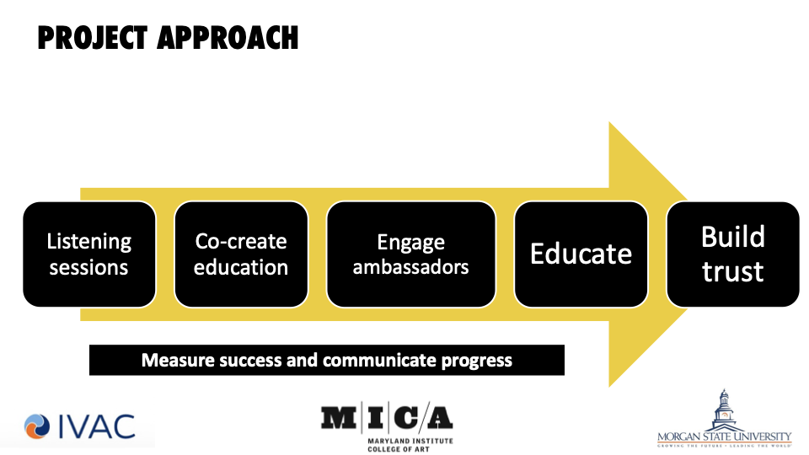
iterate

Slide 10
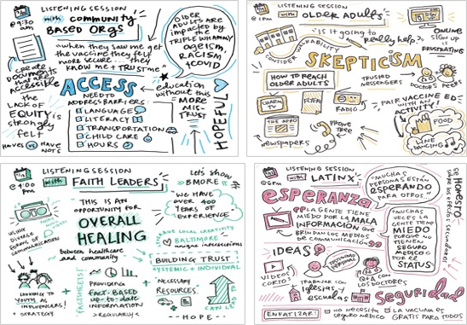

Slide 11
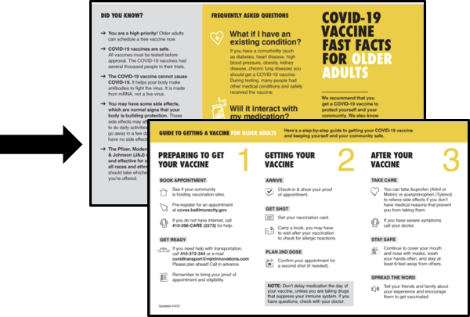
From listening to co-creation

Slide 12
Engaging communities build better messages and trust:
A framework for action
Understand history and context
Listen and have empathy
Understand and engage trusted messengers
Provide shared responsibility for development of messages
Co-create solutions
Test and iterate
Adapted from Privor-Dumm and King, J. Health Communication, 2021

Slide 13
Summary
Messaging benefits from engagement, listening and co-creation
Identifying needs and priorities can improve how messages resonate with older adults
The messenger is just as, if not more important than the messenger
Language drawing from the discussions of older adults can help in customizing messages
True partnerships are invaluable and can facilitate listening and co-creation for effective messages

