Slide 1
The imperative of expanding vaccination pathways and providers
Gonçalo Sousa Pinto
FIP Lead for Practice Development and Transformation

Slide 2
About FIP
Leader of pharmacy at the global level
Founded in 1912, the International Pharmaceutical Federation (FIP) is the global federation of national associations representing millions of pharmacists, pharmaceutical scientists and pharmacy educators around the world.
FIP is a non-governmental organisation that has been in official relations with the World Health Organization since 1948.
Vision
A world where everyone benefits from access to safe, effective, quality and affordable medicines and pharmaceutical care.
Mission
FIP improves global health by supporting the advancement of pharmaceutical practice, sciences and education.

Slide 3
International Pharmaceutical Federation (FIP)
146 member organisations in more than 100 countries and territories
Over 20 Observer Organisations
Over 170 Academic Institutional Members (pharmacy schools)
Over 4 million pharmacists, pharmaceutical scientists and pharmaceutical educators.

Slide 4
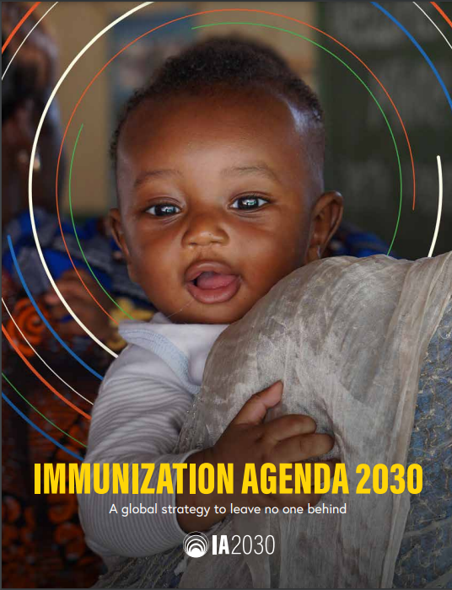
WHO Immunization Agenda 2030:
A Global Strategy to Leave No One Behind
Strategic priority goals:
#3: Everyone is protected by full immunization, regardless of location, age, socioeconomic status or gender-related barriers.
#4: All people benefit from recommended immunizations throughout the life course, effectively integrated with other essential health services.
Strengthen immunization policies and service delivery throughout the life-course, including for appropriate catch-up vaccinations and booster doses.
Establish integrated delivery points of contact between immunization and other public health interventions for different target age groups
WHO. Immunization Agenda 2030 A global strategy to leave no one behind. https://www.who.int/teams/immunization-vaccines-and-biologicals/strategies/ia2030

Slide 5
Expanding and diversifying adult vaccination pathways – a global imperative
Equity across the life-course in access to prevention strategies and well-being – including vaccination services
Older adults and people living with long-term conditions are most vulnerable to severe forms of several vaccine-preventable diseases (namely influenza (1), pneumococcal disease (2) or shingles (3) and other such as COVID-19).
Imperative to expand, diversify and improve accessibility of pathways for adult vaccination to ensure increased uptake and coverage across communities.
Imperative for rapid, country-level readiness for mass immunisation, considering COVID-19 and any future pandemics
Diversifying vaccination providers across healthcare professionals, including medical doctors, nurses and pharmacists
Sources
(1) World Health Organization, Influeza (seasonal). Available at: https://www.who.int/news-room/fact-sheets/detail/influenza-(seasonal)
(2) World Health Organization, Pneumococcal disease. Available at: https://www.who.int/immunization/diseases/pneumococcal/en/
(3) World Health Organization, Varicella. Available at: https://www.who.int/ith/diseases/varicella/en/
(4) World Health Organization, Older people and COVID-19. Available at https://www.who.int/emergencies/diseases/novel-coronavirus-2019/question-and-answers-hub/q-a-detail/q-a-on-on-covid-19-for-older-people
[insert compliance job number]
All rights reserved.
July 2020

Slide 6
Why community pharmacies?
An optimal infrastructure and pathway already exists in the network of community pharmacies for a number of reasons:
Highly skilled and trained health care professionals
Accessibility (within a few minutes from home for most people)
Long opening hours [Large scale US study of 7,800 pharmacies found 30.5% of flu vaccines administered out of hours] (1)
Excellent logistics and cold chain management
Spatial requirements for delivery with appropriate privacy and clinical adequacy
Allowing pharmacy vaccination improves efficiency and increases vaccination rates
Sources
(1) J. Goad, M. Taitel, L. Fensterheim and A. Cannon, Vaccinations administered during off-clinic hours at a national community pharmacy: implications for increasing patient access and convenience, The Annals of Family Medicine, 2013, 11(5), p429-436.
[insert compliance job number]
All rights reserved.
July 2020

Slide 7
Why community pharmacies? (2/2)
Ability to identify high-risk patients based on their medication and other risk factors
Public’s trust and enthusiastic acceptance
Practice guided by nationally adopted standards and guidelines
Improves access to health care in rural and medically under-served areas
Pharmacies are increasingly gateways to care, with the provision of PHC services

Slide 8
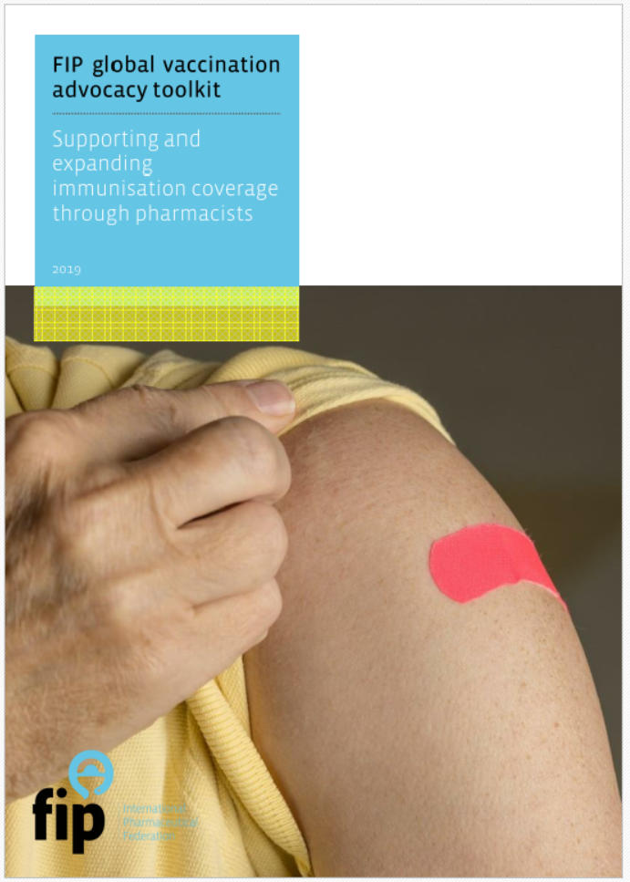
FIP supporting pharmacists’ roles in vaccination
ADVOCACY
PRACTICE SUPPORT
EDUCATION AND WORKFORCE DEVELOPMENT
VACCINE SCIENCE AND IMPLICATIONS FOR PRACTICE
Notes:
An advocacy toolkit to support national pharmacists organisations – be them advocacy bodies, organisations with regulatory responsibilities, academic and scientific leaders – in introducing or expanding pharmacy-based vaccine-related services.
A source of global data, evidence, best practices and expertise that are required for effective advocacy.

Slide 9
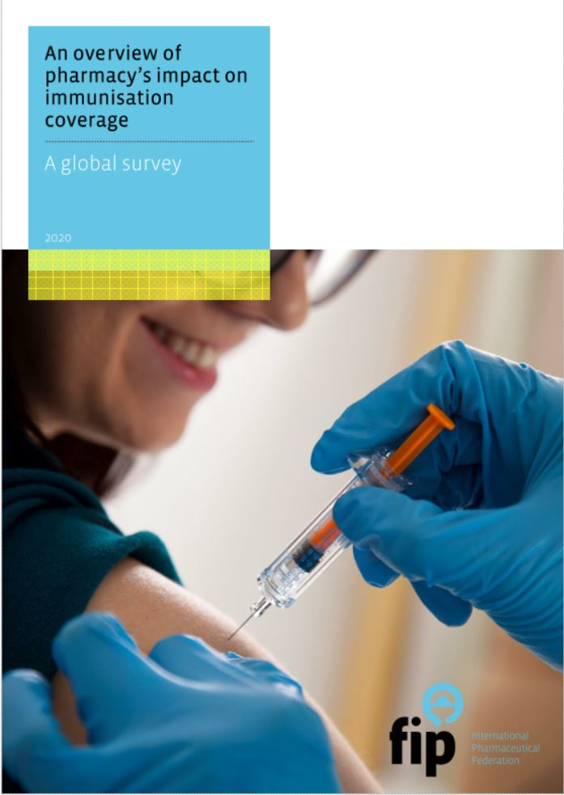
An overview of pharmacy’s impact on immunisation coverage: A global survey - Released in August 2020 - Responses from 106 organisations from 99 countries and territories. Available at: https://www.fip.org/file/4751

Slide 10
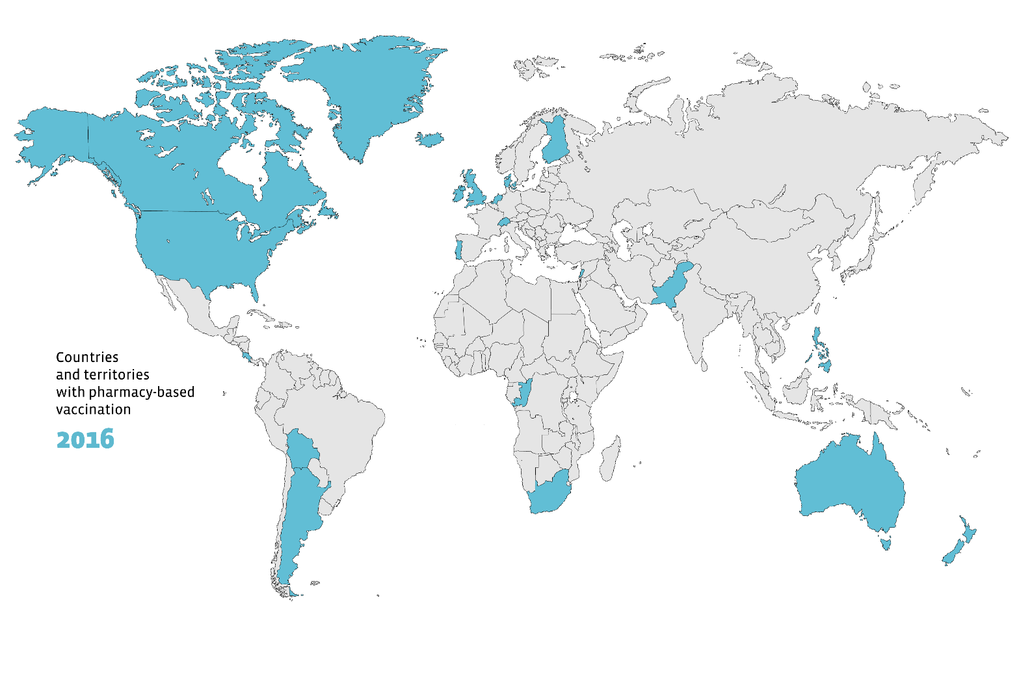
Countries and territories with pharmacy-based vaccination
16
Source
International Pharmaceutical Federation (FIP). An overview of pharmacy’s impact on immunisation coverage: A global survey. The Hague: International Pharmaceutical Federation; 2020

Slide 11
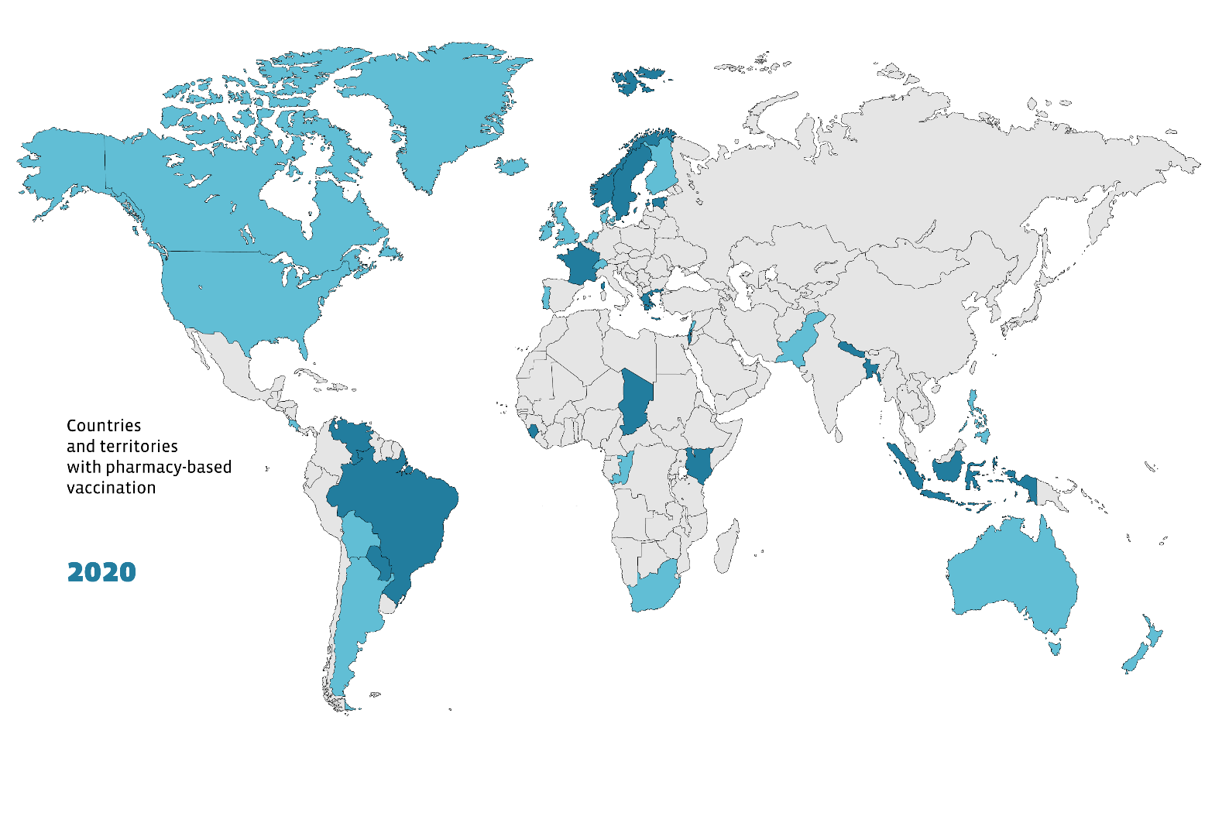
Countries and territories with pharmacy-based vaccination
36
Source
International Pharmaceutical Federation (FIP). An overview of pharmacy’s impact on immunisation coverage: A global survey. The Hague: International Pharmaceutical Federation; 2020

Slide 12
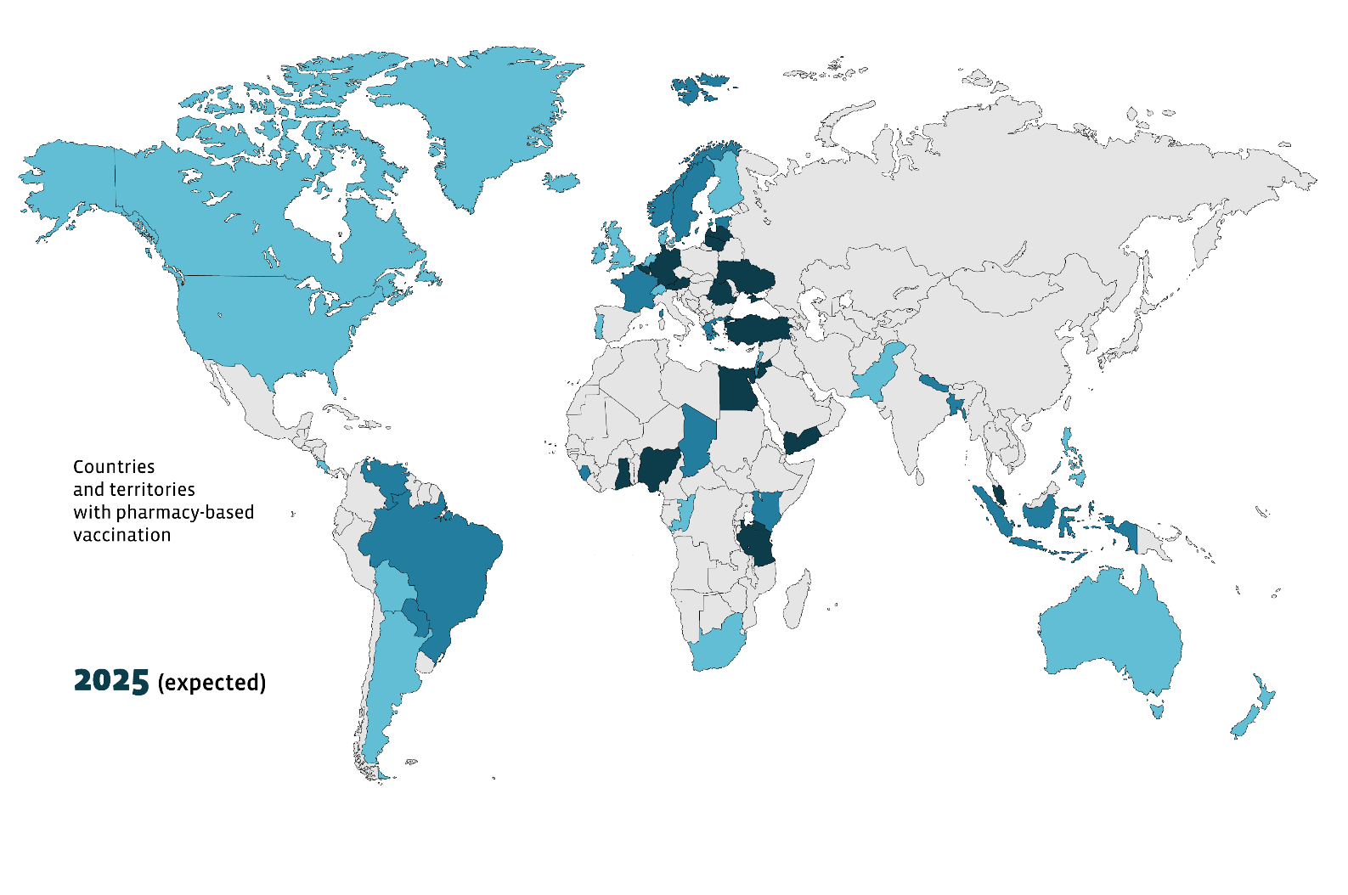
Countries and territories with pharmacy-based vaccination
52
Source
International Pharmaceutical Federation (FIP). An overview of pharmacy’s impact on immunisation coverage: A global survey. The Hague: International Pharmaceutical Federation; 2020
Notes:
An important point to note is that this survey was largely conducted before the COVID-19 pandemic. The pandemic accelerated the introduction of PBV in several countries –including countries not represented in this map, such as Algeria, Italy, Lithuania or Poland.

Slide 13
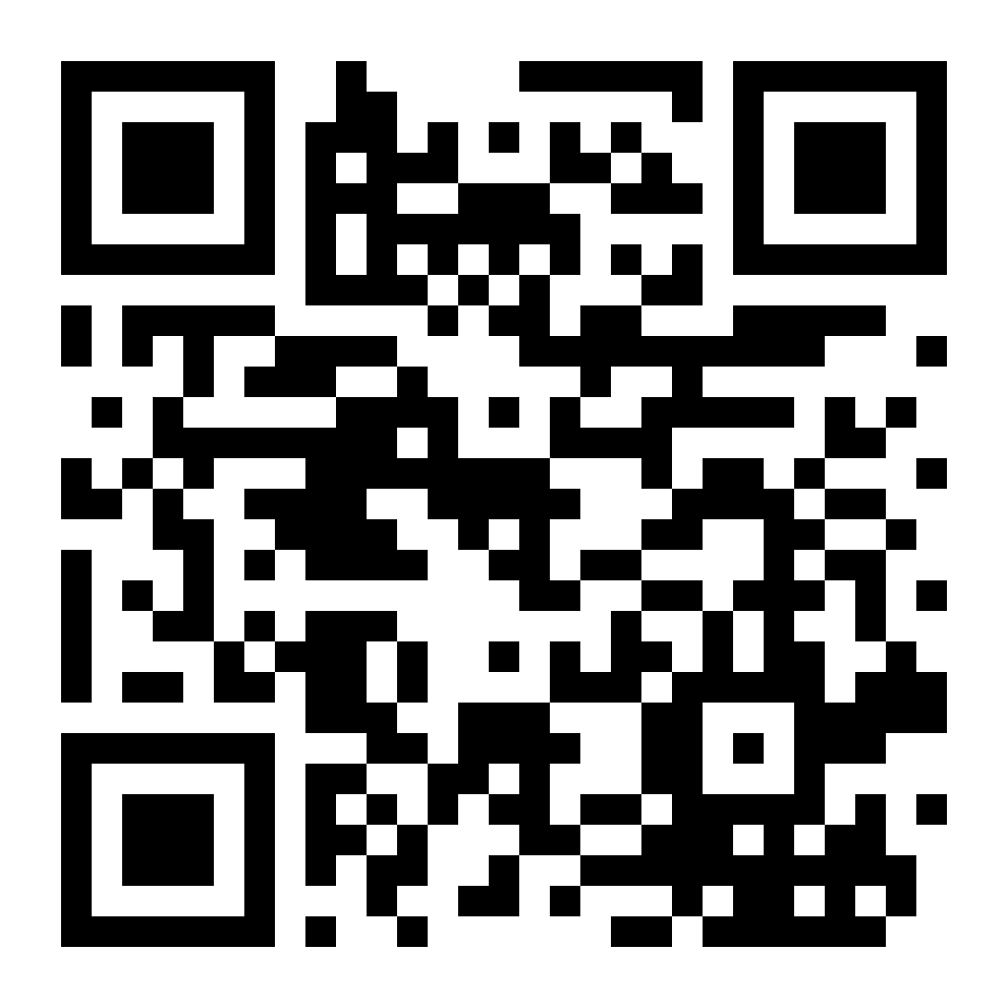
Building vaccine confidence and communicating vaccine value: A toolkit for pharmacists (2021)

Slide 14
Understanding and tackling vaccine hesitancy
Effective approaches to addressing vaccine hesitancy with individuals
Pharmacy-led campaigns
Vaccine information for pharmacists
Building vaccine confidence through pharmacists
Support pharmacy practice development in vaccine hesitancy and complacency
Communicating for change
Conversation examples addressing different concerns and patient profiles
Pharmacy led-campaigns
Examples of campaigns from around the world
Vaccine information and advice
Different vaccine types

Slide 15
Immunisation for All Ages Position Statement Expanding capacity for immunisation beyond infancy (Sept 2021)
Recommendations:
Expand existing and innovate new infrastructure for immunisation beyond the traditional pathways to facilitate and increase access to vaccination services, including but not limited to pharmacies and other appropriate facilities including primary healthcare.
Promote the expansion of trained healthcare professionals as vaccination providers, by eliminating the requirement for a medical prescription for vaccine administration, when clear eligibility criteria and protocols have been developed for each vaccine.
Ensure healthcare professionals across disciplines are well-trained, informed and upskilled on the benefits and administration of vaccines to clearly communicate to hard-to-reach populations.
Ensure equity of access to vaccines and vaccination services across all vaccination pathways, by eliminating the need for out-of-pocket payments by individuals and ensuring appropriate remuneration models for all vaccination providers.
IFAA:

Slide 16
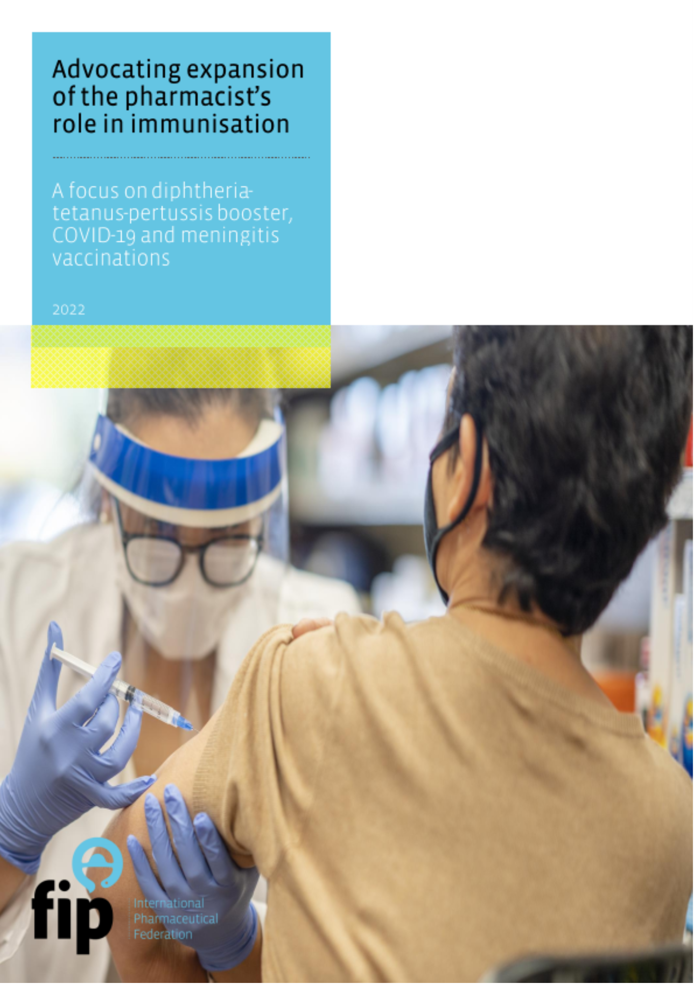
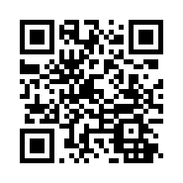
Beyond the pandemic
New evidence that pharmacists’ impact on improving vaccination coverage globally is growing.
The COVID-19 pandemic has provided further affirmation of the accessibility and availability of pharmacists as front-line providers of people-centred care.
Beyond the pandemic, efforts to support and expand pharmacy-based vaccination services must continue as a necessary route to achieving universal health coverage.
Launched on 28 April 2022

Slide 17
Thank you.
gspinto@fip.org

