Slide 1
Healthcare providers as advocates for vaccination policy: A focus on pharmacist-led advocacy
Gonçalo Sousa Pinto
Lead for Practice Development and Transformation
International Pharmaceutical Federation (FIP)

Slide 2
International Pharmaceutical Federation (FIP)
The International Pharmaceutical Federation (FIP) is the global body representing pharmacy, pharmaceutical sciences and pharmaceutical education, in official relations with the World Health Organization.
Through our 156 national organisations and our academic institutional members and individual members, we represent over four million pharmacists, pharmaceutical scientists and pharmaceutical educators around the world.
We work to support the development of the pharmacy profession, through practice and emerging scientific innovations, and through developing the pharmacy workforce in order to meet the world’s health care needs and expectations.

Slide 3
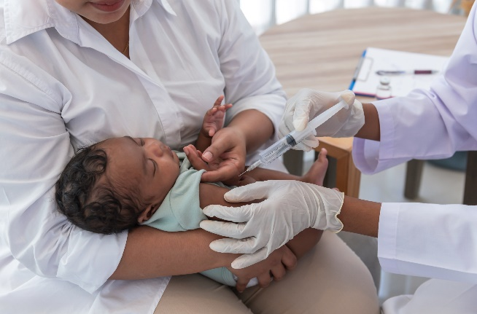
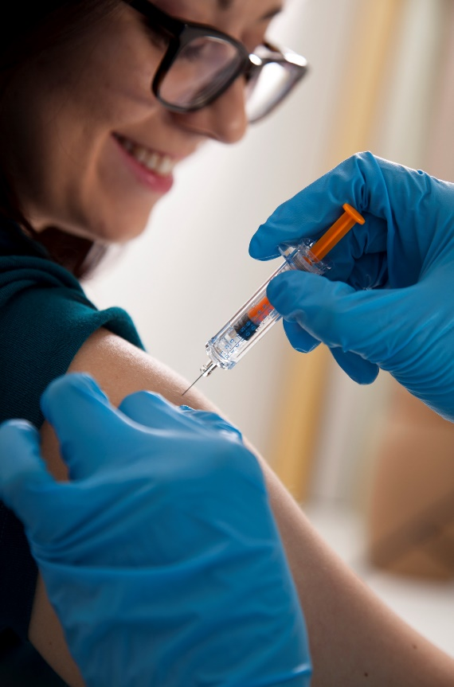
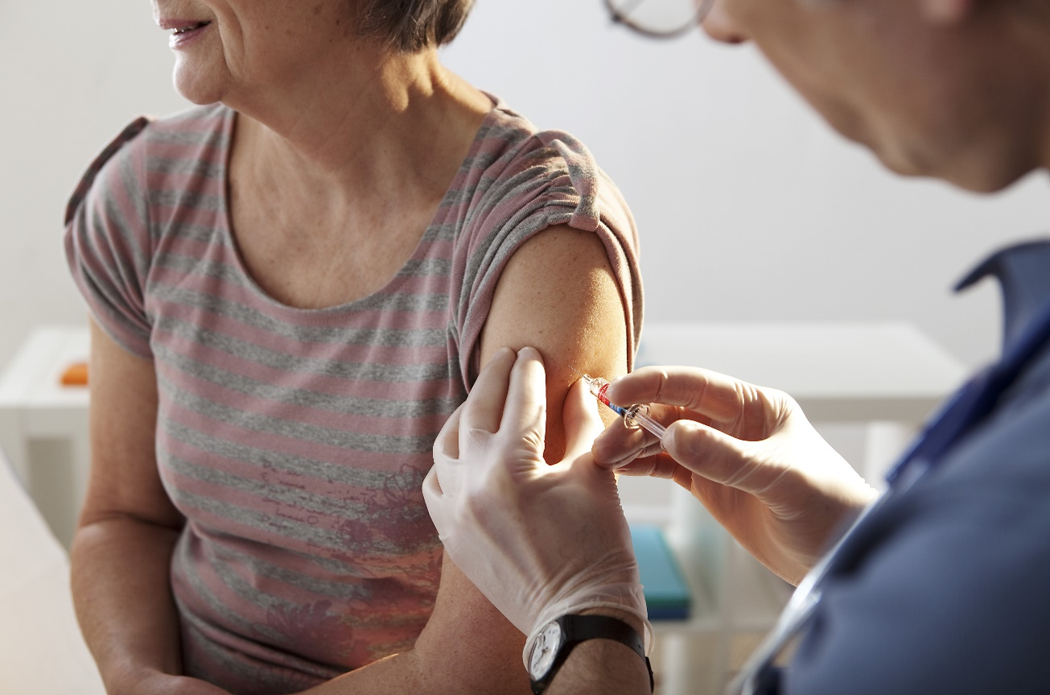
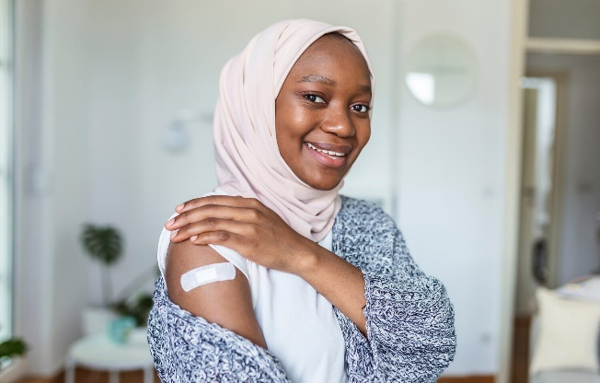
Vaccines save lives, protect health, functional ability and well-being.
Across all ages.
Target: 90%
Target: 75%
Notes:
Over recent years, FIP has grown both our advocacy and policy efforts to expand the roles of pharmacists related to vaccination promotion and administration at global, regional and national levels. Prevention is better than cure and we know that vaccination is the second most effective public health intervention after clean water. Our work on vaccination is based on the conviction that improving vaccination coverage and promoting a life-course approach to vaccination are global imperatives to which pharmacists can greatly contribute.
Vaccines save lives ad they protect health, functional ability and well-being across all ages. Yet, the targets set for childhood vaccination are 90%, while for the vaccination of older adults, only a target for flu is set by WHO and it is 75%. In addition, very few countries actually meet this target for flu vaccination of older adults, not to mention other live-saving vaccines, like pneumococcal.

Slide 4
Aligning advocacy with global health imperatives and policy agendas

Slide 5
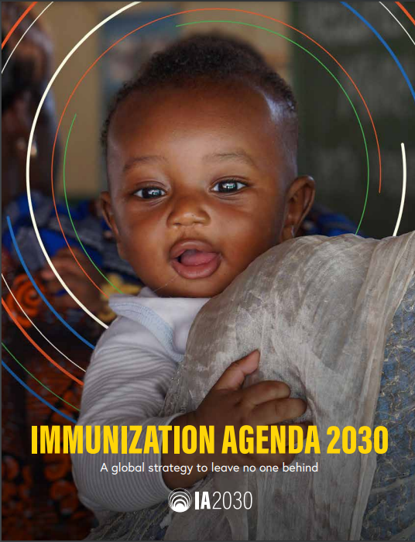
WHO immunisation Agenda 2030:
A global strategy to leave no one behind
Selected priority strategic objectives:
#3: Everyone is protected by full immunisation, regardless of location, age, socioeconomic status or gender-related barriers.
#4: All people benefit from recommended immunisations throughout life, effectively integrated with other essential health services.
Strengthen immunization policies and service delivery throughout the life cycle, including for appropriate vaccinations and booster doses.
Establish integrated points of contact between immunisation and other public health interventions for different target age groups
WHO. Immunization Agenda 2030 A global strategy to leave no one behind. https://www.who.int/teams/immunization-vaccines-and-biologicals/strategies/ia2030

Slide 6
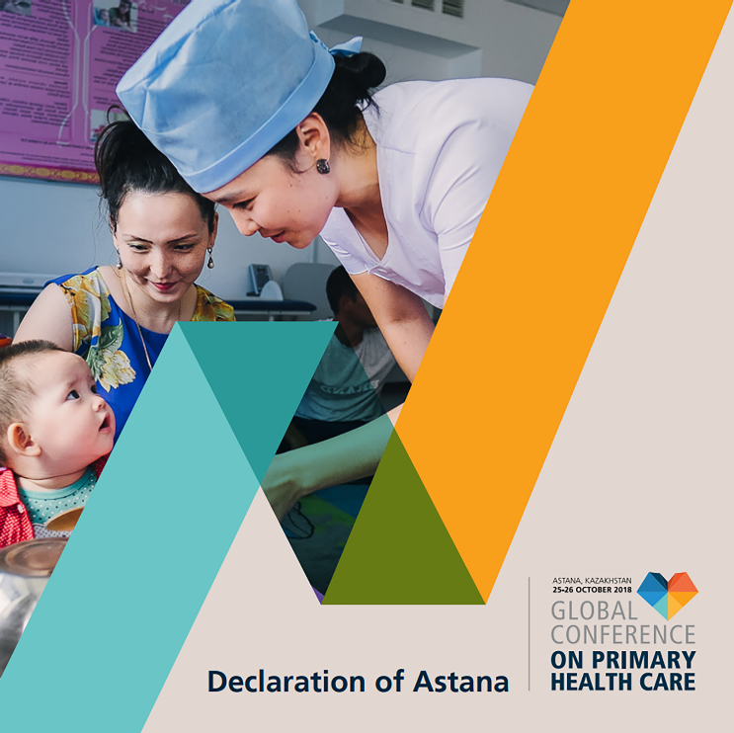
WHO’s Declaration of Astana on Primary Healthcare
2. Empowering individuals, families and communities to take charge of their own health
3. Addressing the wider determinants of health through multisectoral policies and actions
Addressing the wider determinants of health through multisectoral policies and actions
1. Integrated health services to meet people's health needs throughout the life course
WHO, https://www.who.int/health-topics/primary-health-care#tab=tab_1
Notes:
Everyone, everywhere, has the right to the highest attainable standard of health. This is the fundamental premise of primary health care (PHC).
Primary health care enables health systems to address people's health needs, from health promotion to disease prevention, treatment, rehabilitation, palliative care, etc. It also ensures that health care is delivered in a way that is centred on people's needs and respects their preferences.
Primary health care is widely regarded as the most inclusive, equitable and cost-effective way to achieve universal health coverage. It is also central to strengthening the resilience of health systems to prepare for, respond to and recover from shocks and crises.

Slide 7
United Nations’ Decade of Healthy Ageing
Life-course vaccination as a pillar of healthy ageing and the preservation of functional ability at all ages

Slide 8
Pharmacists are part of the solution FIP’s priority programmes and advocacy on vaccination

Slide 9
The FIP Development Goals reiterate FIP’s commitment to global health.
Notes:
In 2020, FIP launched FIP Development Goals, or FIP DGs, to align the work of FIP with global health and sustainable development priorities.

Slide 10
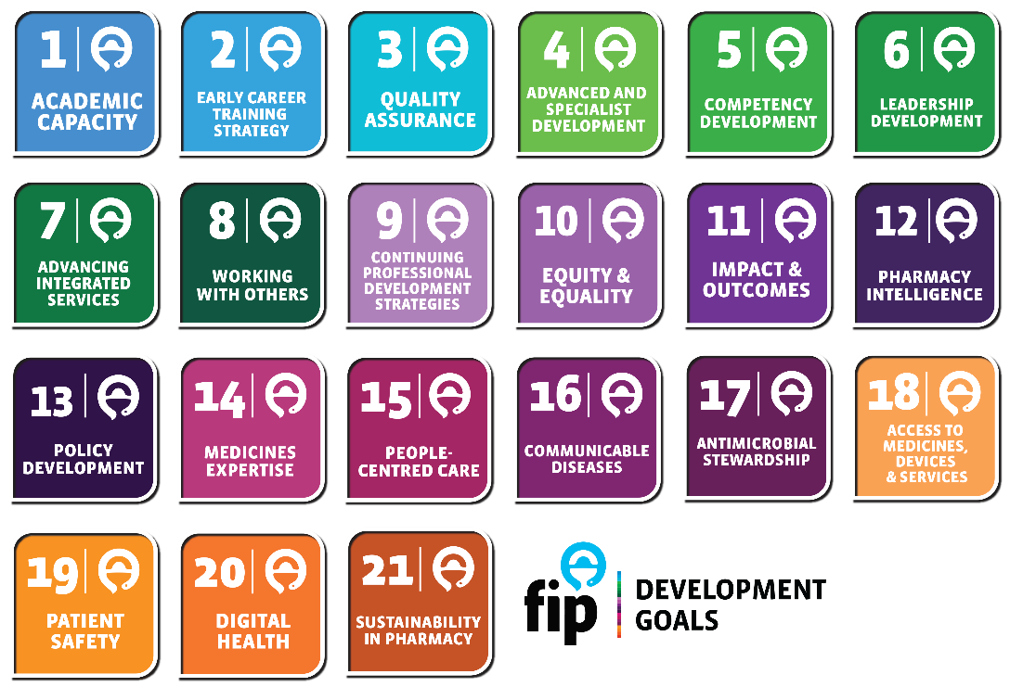
Pharmacy-based vaccination and vaccine-related services are linked to 14 of the 21 FIP Development Goals, with a central role in 8 of them

Slide 11
Vaccination work core to FIP’s disease prevention programme
Towards healthier lives and sustainable healthcare
prevention.fip.org
Notes:
FIP’s disease prevention programme aims to advance the role of pharmacists in the area of disease prevention strategies that enable us to remain healthy, functional and productive, leading to happier lives, stronger economic growth and less pressure on health systems. Pharmacists can have roles in health promotion and literacy, self-care, management of self-limiting conditions, vaccination and prevention of communicable and vector-borne diseases. A key element of the prevention programme is the role of pharmacists in improving vaccination coverage rates throughout the life course.

Slide 13
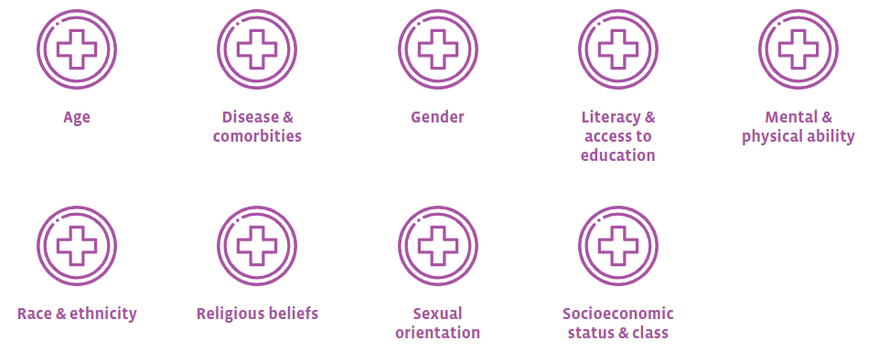
FIP-EquityRx & FIP Development Goal 10 Leaving no one behind
Notes:
FIP Development Goal 10: Equity & Equality and the EquityRx programme support the equitable access to health care for all individuals, regardless of the following social, demographic and health identifiers & their intersectionality:
Age
Disease and comorbities
Gender
Literacy & access to education
Mental and physical ability
Race and ethnicity
Religious beliefs
Sexual orientation
Socioeconomic status and class

Slide 14
Timeline of FIP’s vaccination work 2011-2019
The beginning of the journey
Notes:
Our vaccination work spans more than a decade, marked in 2011 with the joint WHO-FIP Good Pharmacy Practice guidelines, where the administration of medicines, vaccines and other injectables is defined as a key role of pharmacists. Prior to that, FIP focused on observing and understanding vaccination trends through our member organisations. The 2011 milestone report was followed by a number of other key global reports, toolkits as well as a 2018 Summit on advocating for pharmacist’ role in immunisation.

Slide 15
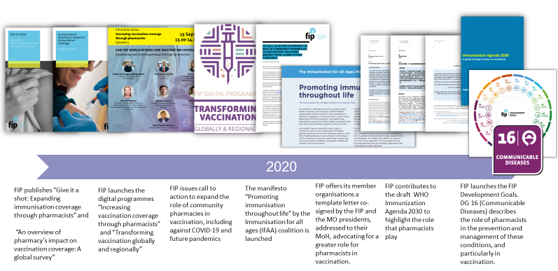
Timeline of FIP’s vaccination work 2020
Notes:
2020 saw the launch of the FIP Development Goals, including Goal 16 “Communicable diseases” which further cements the role of pharmacists in disease prevention. That year also saw the launch of global reports, calls to action, and advocacy tools to support our members worldwide. In the same year, FIP launched the first digital programme “Transforming Vaccinations Globally and Regionally” that addressed the essential role pharmacists play in saving the lives of millions through the provision of vaccines. This programme built on the decade of work FIP had led in vaccinations, but with a particular urgency given the pandemic we found ourselves in.

Slide 16
Timeline of FIP’s vaccination work 2021
Notes:
In 2021, FIP also published several other publications including toolkits and handbooks to support pharmacists and pharmacy-based vaccination. In addition, FIP launched the second digital programme ‘Transforming Vaccination Globally and Regionally’ that included a series of digital events, a commitment, a collection on transforming vaccination through pharmacy, as well as a call to action to transform vaccination.

Slide 17
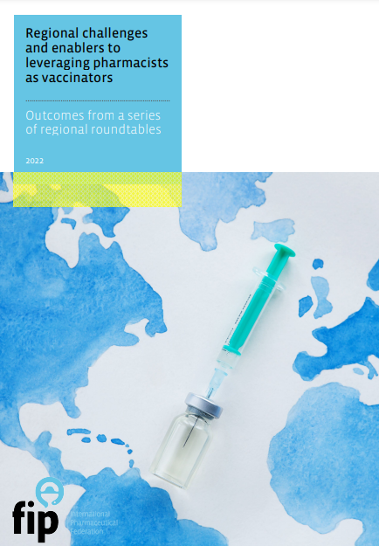
Timeline of FIP’s vaccination work 2022
Notes:
In 2022, several other publications were also published on vaccination with a focus on COVID19. Other publications address pharmacy education on vaccination, vaccine hesitancy and complacency, as well as regional challenges and enablers of pharmacy-based vaccination.

Slide 18
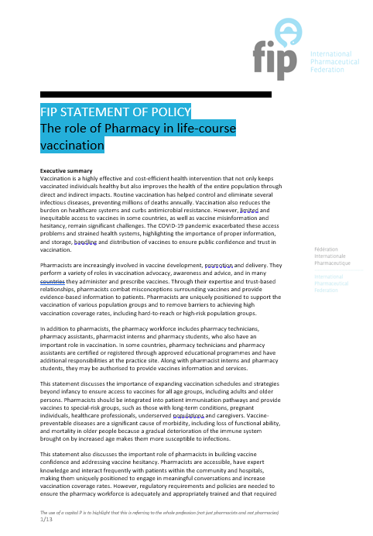
New FIP Statement of Policy on the Role of Pharmacy in Life-Course Vaccination (Sept 2023)
Key Recommendations for policy makers
Develop formal vaccination schedules that support life-course immunisation
Recognise, enable and fully harness the potential and convenience of community and hospital pharmacies
Develop country appropriate policies and remove regulatory barriers
Adopt new vaccination policies which will authorise and empower pharmacists to administer and prescribe vaccines
Develop appropriate remuneration models for pharmacies to deliver sustainable life-course vaccination services within the private and public sector
Ensure health system preparedness and readiness for mass immunisation
Include pharmacists and other pharmacy workforce in emergency preparedness and response plans as frontline health workers
Establish effective immunisation information systems accessible to healthcare professionals
International Pharmaceutical Federation. FIP statement of policy on the role of pharmacy in life-course vaccination. The Hague: FIP, 2023. Available at: https://www.fip.org/file/5619#:~:text=IN%20ADDITION%2C%20FIP%20COMMITS%20TO%3A&text=Support%20this%20important%20role%20of,and%20disinformation%20around%20the%20world. Accessed: December 2023.
Notes:
106. International Pharmaceutical Federation. FIP statement of policy on the role of pharmacy in life-course vaccination. The Hague: FIP, 2023. Available at: https://www.fip.org/publications?publicationCategory=25&publicationYear=&publicationKeyword=.

Slide 19
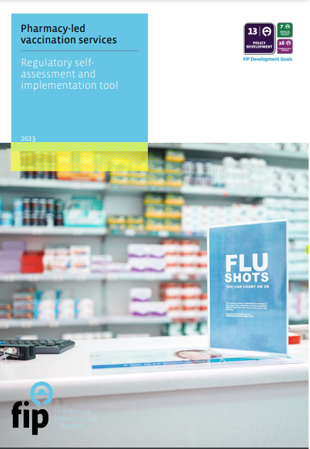
Regulatory self-assessment and implementation tool for pharmacy-led vaccination services
https://prevention.fip.org/vaccination
Notes:
This self-assessment tool will help to identify strengths and areas for improvement in order to inform
vaccination policy and planning efforts. It is an aid to help national ministries of health, regulators and
national pharmacy organisations in assessing overall vaccination programmes and the state of legislation and
regulations within their countries to facilitate vaccination and enhanced patient care through the pharmacy
workforce and community pharmacies. The tool will help with vaccination planning and the utilisation of the
pharmacy workforce in primary healthcare and community-based vaccination programmes.
Regional challenges
and enablers to
leveraging pharmacists:
as vaccinators serve as a starting point for more vaccine-related discussions around the world and
that we can enable multiprofessional vaccine prescribing and administration as a patient-centred approach

Slide 20
Policy enabler toolkit for pharmacists (2023)
Introduction – building on FIP’s work to accelerate life course immunisation
Country models & key policy enablers and barriers around:
Vaccine regulations and prescribing
Service remuneration models
Access to data and vaccination records
Notes:
Today, we’re pleased announce the launch of the policy enabler toolkit that is part of this programme on life course immunisation.
The toolkit “Supporting life-course immunisation through pharmacy-based vaccination: enabling equity, access and sustainability “ outlines three key policy areas that need to be addressed: 1) Regulations and prescribing; 2) Service remuneration models; and 3) Access to data and vaccination records. For each area, case studies from different countries are presented along with enablers and barriers.
I will handover to Lina now who will take you through the contents of the toolkit.

Slide 21
Pharmacy-based vaccination
Recent developments
Case studies
Country updates
Success stories
Insights into implementation challenges and solutions
To be launched on 14 December 2023

Slide 22
New campaign to be launched in the coming days

Slide 23
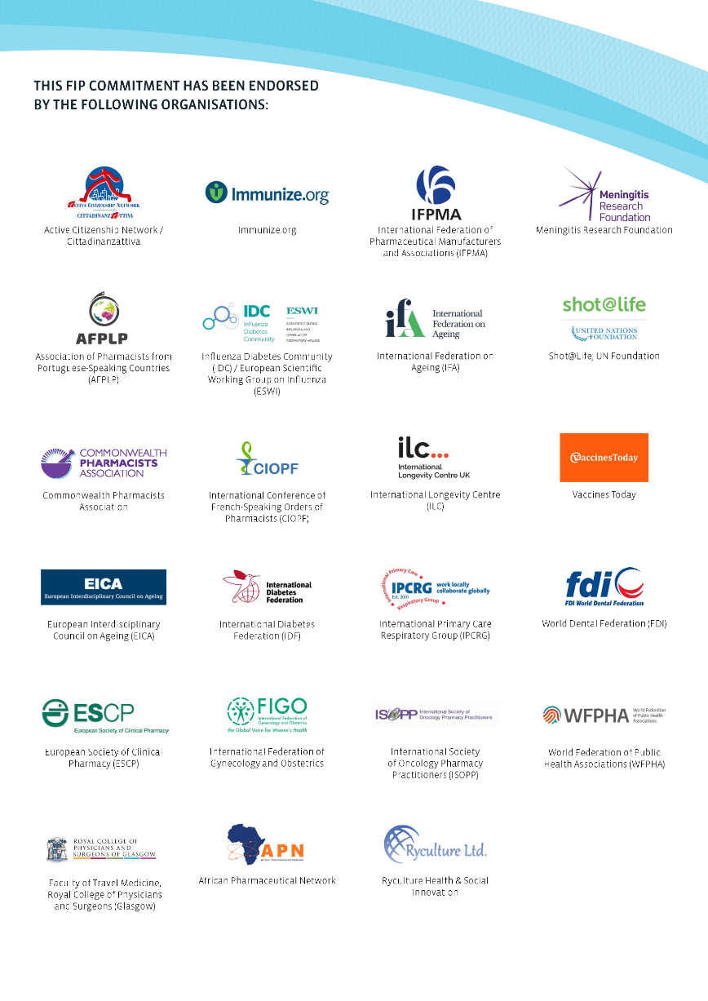
Collaborative advocacy – stronger together!
Building vaccine confidence and communicating vaccine value: A key role by pharmacists
A FIP commitment to action endorsed by 23 organisations
Notes:
In addition to administering vaccines, pharmacists have a range of other roles related to vaccination, including educating patients and the community about vaccine safety and effectiveness, and therefore build vaccine confidence and addressing vaccine complacency. This role has been described in an FIP Commitment and recognised by 23 international organisations and global stakeholders.

Slide 24
Collaborative advocacy – stronger together! The Immunisation For All Ages (IFAA) initiative
The IFAA initiative is working to combat inequity and improve access to immunisation. To achieve this, efforts in support of a life course approach to immunisation must be strengthened through strategic alignment with international health agendas.
The IFAA therefore calls upon national and international health and advocacy organisations and governments to¹
Remove barriers to
access for appropriate
immunisation throughout
life to ensure all people
are protected and no one
is left behind.
Reduce inequities in
timely, appropriate,
and affordable access
to immunisation
throughout life.
Prioritise immunisation throughout life as a key pillar of expanded prevention strategies and a central component of
universal health coverage.
3
1
2
1. IFAA. The Immunisation for All Ages Manifesto: Promoting immunisation throughout life. Available at: https://ifa.ngo/wp-content/uploads/2021/04/IFAA-manifesto-2021.pdf. Accessed August 2022
Notes:
1. IFAA. The Immunisation for All Ages Manifesto: Promoting immunisation throughout life. Available at: https://ifa.ngo/wp-content/uploads/2021/04/IFAA-manifesto-2021.pdf. Accessed August 2022

Slide 25
IFAA Calls to Action
Recognise immunisation as a crucial component of universal healthcare and the role of existing vaccines in supporting health, wealth, and system sustainability.⁴⁴
Ensure all countries have a National Immunisation Technical Advisory Group (NITAG) that includes representation from experts across the life course and civil society organisations.⁴⁴
44. IFAA. The Immunisation for All Ages Manifesto: Promoting immunisation throughout life. Available at: https://ifa.ngo/wp-content/uploads/2021/04/IFAA-manifesto-2021.pdf. Accessed August 2022
Notes:
44. IFAA. The Immunisation for All Ages Manifesto: Promoting immunisation throughout life. Available at: https://ifa.ngo/wp-content/uploads/2021/04/IFAA-manifesto-2021.pdf. Accessed August 2022

Slide 26
IFAA Call to Actions
Expand existing and innovate new infrastructure for immunisation beyond the traditional pathways to facilitate and increase access to vaccination services, including pharmacies.¹⁰⁷
Increase investment on prevention and, within that, increase the proportion of investment on immunisation.¹⁰⁷
107. IFAA. The Immunisation for All Ages Manifesto: Promoting immunisation throughout life. Available at: https://ifa.ngo/wp-content/uploads/2021/04/IFAA-manifesto-2021.pdf. Accessed August 2022
Notes:
107. IFAA. The Immunisation for All Ages Manifesto: Promoting immunisation throughout life. Available at: https://ifa.ngo/wp-content/uploads/2021/04/IFAA-manifesto-2021.pdf. Accessed August 2022

Slide 27
IFAA Call to Actions
Increase public confidence in vaccines by driving health-seeking behaviour and communicating the value of immunisation to the public through trusted stakeholders (such as healthcare professionals and allied health professionals).⁶⁹
Ensure existing vaccine uptake targets are met and strive for consistent vaccination targets of 90% throughout life.⁶⁹
69. IFAA. The Immunisation for All Ages Manifesto: Promoting immunisation throughout life. Available at: https://ifa.ngo/wp-content/uploads/2021/04/IFAA-manifesto-2021.pdf. Accessed August 2022
Notes:
69. IFAA. The Immunisation for All Ages Manifesto: Promoting immunisation throughout life. Available at: https://ifa.ngo/wp-content/uploads/2021/04/IFAA-manifesto-2021.pdf. Accessed August 2022

Slide 28
Some outputs of continued advocacy Persistence, persistence, persistence!

Slide 29
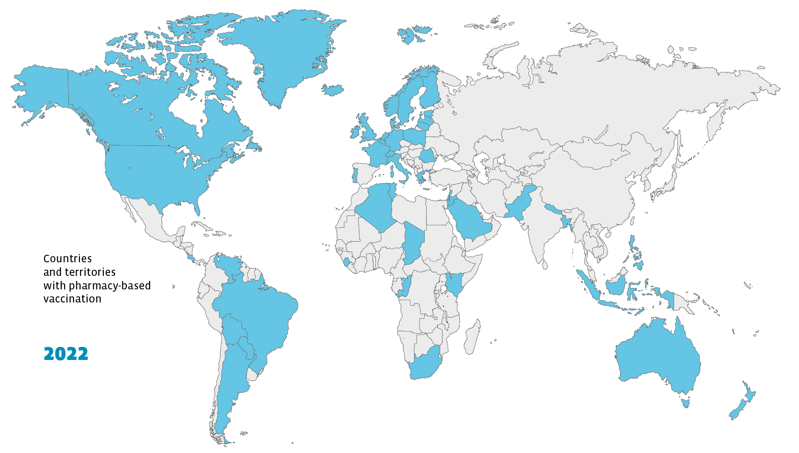
Countries and territories with pharmacy-based vaccination⁷³
Since 2020:
Algeria⁷⁴
Belgium⁷⁵
Germany⁷⁵
Italy⁷⁵
Jordan⁷⁵
Latvia⁷⁶
Lithuania⁷⁷
Poland⁷⁸
Romania^{78,79}
Saudi Arabia⁷⁵
Tunisia⁸⁰
UAE⁸¹
48
Countries and territories with pharmacy-based vaccination in 2022⁷³
As of August 2023
73. International Pharmaceutical Federation (FIP). An overview of the impact of pharmacy on immunization coverage: A global survey. The Hague: International Pharmaceutical Federation; 2020 Available at: https://www.fip.org/file/4751 Accessed September 2022
74. Algérie Presse Service. Covid-19: 1,200 pharmaciens adhèrent à l'opération de vaccination [Internet]. 2021. updated [accessed: 22 August 2022]. Available from: https://www.aps.dz/sante-science-technologie/127354-covid-19-1-200- pharmaciens-adherent-a-a-l-operation-de-vaccination-des-citoyens.
75. International Pharmaceutical Federation. Making the case for expanding the role of the pharmacist in immunization: A focus on diphtheria-tetanus-pertussis booster, COVID-19, and meningitis vaccinations. The Hague: [Internet]. 2022. [accessed: 22 August 2022]. Available from: https://www.fip.org/file/5137
76. Baltic News Network. Latvian government allows pharmacies to carry out Covid-19 vaccination [Internet]. 2021. updated December 15, 2021. [accessed: 22 August 2022]. Available from: https://bnn-news.com/latvian-government-permitspharmacies-to-perform-covid-19-vaccination-230920.
77. European Observatory on Health Systems and Policies. COVID-19 vaccine deployment [Internet]. 2021. updated 14 December 2021. [accessed: 22 August 2022]. Available from: https://eurohealthobservatory.who.int/monitors/hsrm/allupdates/hsrm/lithuania/covid-19-vaccine-deployment.
78. Romanian Ministry of Health. ORDEN No. 2.382 din 4 noiembrie 2021 [Internet]. 2021. updated [accessed: Available: https://legislatie.just.ro/Public/DetaliiDocument/248262.
79. Birsanu S-E, Banu O-G, NANU C-A. ASSESSING LEGAL LIABILITY IN ROMANIAN PHARMACEUTICAL PRACTICE. PHARMACY. 2022;70(3):557-64. [accessed: 1 September 2022]. Available at: https://farmaciajournal.com/wpcontent/uploads/art-24-Birsanu_Banu_Nanu_557-564.pdf.
80. Syndicat des Pharmaciens d'Officine de Tunisie. Guide de la vaccination dans les officine [Internet]. 2021. updated August 12, 2021. [accessed: 22 August 2022]. Available from: https://spot.tn/?mayor=articles&id=975.
81. Nandini Sircar, « UAE pharmacies to soon provide Covid-19 and influenza vaccines”, Khaleej Times, 26 September 2022, https://www.khaleejtimes.com/uae/uae-pharmacies-to-soon-provide-covid-19-and-influenza-vaccines
Notes:
73. International Pharmaceutical Federation (FIP). An overview of the impact of pharmacy on immunization coverage: A global survey. The Hague: International Pharmaceutical Federation; 2020 Available at: https://www.fip.org/file/4751 Accessed September 2022
74. Algérie Presse Service. Covid-19: 1,200 pharmaciens adhèrent à l'opération de vaccination [Internet]. 2021. updated [accessed: 22 August 2022]. Available from: https://www.aps.dz/sante-science-technologie/127354-covid-19-1-200- pharmaciens-adherent-a-a-l-operation-de-vaccination-des-citoyens.
75. International Pharmaceutical Federation. Making the case for expanding the role of the pharmacist in immunization: A focus on diphtheria-tetanus-pertussis booster, COVID-19, and meningitis vaccinations. The Hague: [Internet]. 2022. [accessed: 22 August 2022]. Available from: https://www.fip.org/file/5137
76. Baltic News Network. Latvian government allows pharmacies to carry out Covid-19 vaccination [Internet]. 2021. updated December 15, 2021. [accessed: 22 August 2022]. Available from: https://bnn-news.com/latvian-government-permitspharmacies-to-perform-covid-19-vaccination-230920.
77. European Observatory on Health Systems and Policies. COVID-19 vaccine deployment [Internet]. 2021. updated 14 December 2021. [accessed: 22 August 2022]. Available from: https://eurohealthobservatory.who.int/monitors/hsrm/allupdates/hsrm/lithuania/covid-19-vaccine-deployment.
78. Romanian Ministry of Health. ORDEN No. 2.382 din 4 noiembrie 2021 [Internet]. 2021. updated [accessed: Available: https://legislatie.just.ro/Public/DetaliiDocument/248262.
79. Birsanu S-E, Banu O-G, NANU C-A. ASSESSING LEGAL LIABILITY IN ROMANIAN PHARMACEUTICAL PRACTICE. PHARMACY. 2022;70(3):557-64. [accessed: 1 September 2022]. Available at: https://farmaciajournal.com/wpcontent/uploads/art-24-Birsanu_Banu_Nanu_557-564.pdf.
80. Syndicat des Pharmaciens d'Officine de Tunisie. Guide de la vaccination dans les officine [Internet]. 2021. updated August 12, 2021. [accessed: 22 August 2022]. Available from: https://spot.tn/?mayor=articles&id=975.
81. Nandini Sircar, « UAE pharmacies to soon provide Covid-19 and influenza vaccines”, Khaleej Times, 26 September 2022, https://www.khaleejtimes.com/uae/uae-pharmacies-to-soon-provide-covid-19-and-influenza-vaccines

Slide 30
Prescribing authority: Simplifying the patient journey

Slide 31
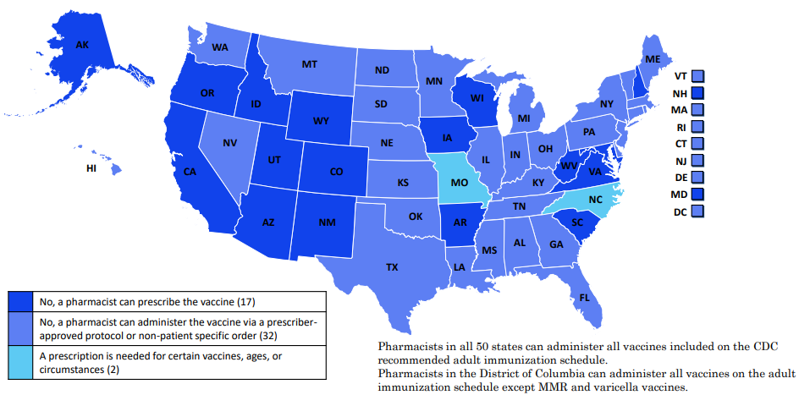
USA: Does a patient need a prescription for a pharmacist to administer a vaccine from the adult immunisation programme?
NASPA, USA, https://naspa.us/resource/pharmacist-authority-to-immunize/

Slide 32
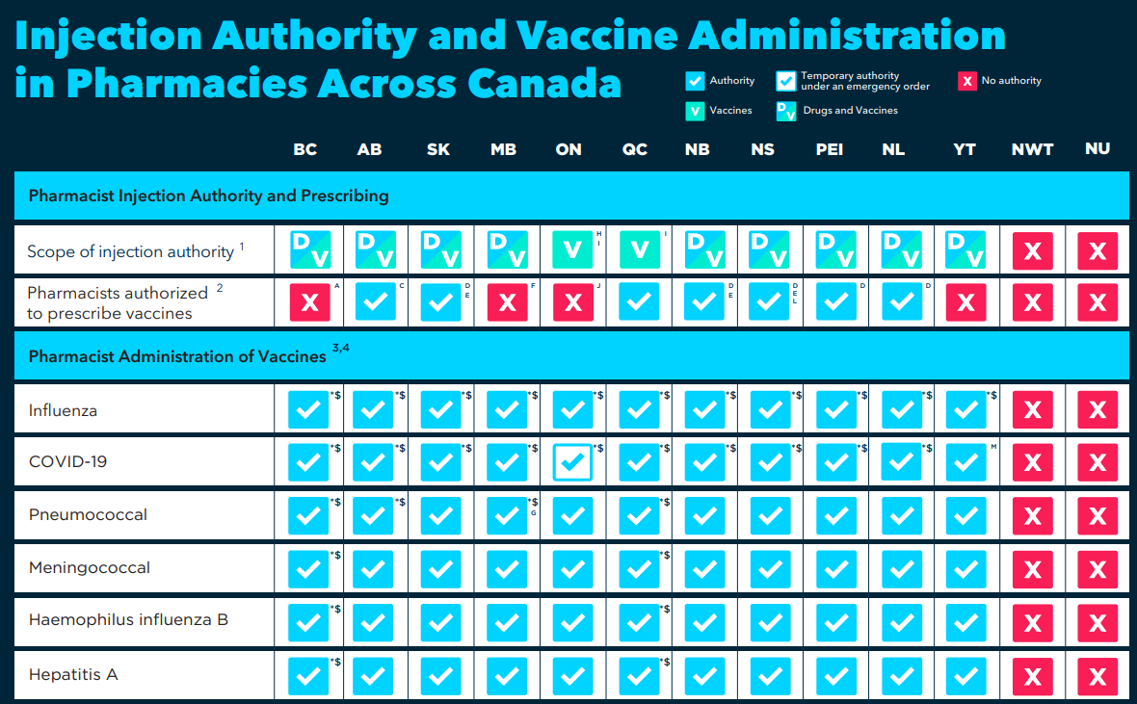
CANADA
Canadian Pharmacists Association, https://www.pharmacists.ca/cpha-ca/assets/File/cpha-on-the-issues/Immunization_ChartOct.pdf

Slide 33
PORTUGAL
Without prescription
No out-of-pocket payment
Vaccines Today: https://www.vaccinestoday.eu/stories/pharmacy-pilot-project-increases-flu-vaccination-by-32/

Slide 34
Ireland: Flu Vaccination Rates 2008 -2020
Start of
vaccination in pharmacies
Pharmacies now account for 24.8% of flu vaccines in primary care
In the 20/21 season ~ 85% of all pharmacies provided a flu vaccination service
Slide by Mr Dermot Twomey - President, Irish Pharmacies Union

Slide 35
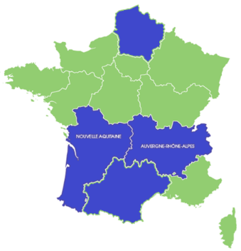
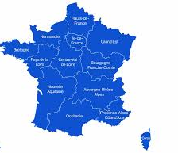
France: The role of the pharmacists in vaccination since 2017
2017*⁹¹
2018⁹²
2019⁹³
2021⁹⁴
2022⁹⁵
2023⁹⁶
Administration of other vaccines:
National-level
Prescription of other vaccines:
National-level
Influenza:
4-pilot regions
Influenza:
National-level
Influenza and COVID-19:
National-level
* First pilot regions in Auvergne–Rhône Alpes and Nouvelle Aquitaine
- Pharmacy based vaccination
- No Pharmacy based vaccination
91. Pfizer Data on file. “Access to Immunisation as a Tool for Improving Public Health: Evidence for Pharmacy-Based Services. Workshop Session”. Alphega Pharmacy Convention 2019. Slides 10 and 11.​
92. M. Kroemer, A.L. Clairet, K. Kabiche, A. Bendjama, X. Bertrand, S. Limat, V. Nerich, Influenza vaccination coverage at community pharmacies: Positioning, needs, expectations and involvement of community pharmacists in the Franche-Comté region, Infectious Diseases Now,nVolume 51, Issue 3, 2021, Pages 285-289, ISSN 2666-9919, https://doi.org/10.1016/j.medmal.2020.10.012. Accessed August 2023
93. République française (2019). Order of 23 April 2019 setting the list of vaccinations that community pharmacists can carry out pursuant to 9° of article L. 5125-1-1 A of the public health code, https://www.legifrance.gouv.fr/jorf/id/JORFARTI000038409909. Accessed March 2022.​
94. ​République française (2021). Decree No. 2021-248 of March 4, 2021 amending Decrees No. 2020-1262 of October 16, 2020 and No. 2020-1310 of October 29, 2020 prescribing the general measures necessary to deal with the covid-19 epidemic in the framework of the state of health emergency. https://www.legifrance.gouv.fr/jorf/id/JORFTEXT000043216584. Accessed March 2022
95. Haute Autorité de Santé (2022). Expanding the skills of three health professions to facilitate vaccination. https://www.has-sante.fr/jcms/p_3312582/fr/elargir-les-competences-de-trois-professions-de-sante-pour-faciliter-la-vaccination. Accessed March 2022
96. République française (2022). Order of January 26, 2022 amending the order of June 1, 2021 prescribing the general measures necessary for managing the end of the health crisis. https://www.legifrance.gouv.fr/jorf/id/JORFARTI000045076545. Accessed March 2022
Notes:
91. Pfizer Data on file. “Access to Immunisation as a Tool for Improving Public Health: Evidence for Pharmacy-Based Services. Workshop Session”. Alphega Pharmacy Convention 2019. Slides 10 and 11.​
92. M. Kroemer, A.L. Clairet, K. Kabiche, A. Bendjama, X. Bertrand, S. Limat, V. Nerich, Influenza vaccination coverage at community pharmacies: Positioning, needs, expectations and involvement of community pharmacists in the Franche-Comté region, Infectious Diseases Now,nVolume 51, Issue 3, 2021, Pages 285-289, ISSN 2666-9919, https://doi.org/10.1016/j.medmal.2020.10.012. Accessed August 2023
93. République française (2019). Order of 23 April 2019 setting the list of vaccinations that community pharmacists can carry out pursuant to 9° of article L. 5125-1-1 A of the public health code, https://www.legifrance.gouv.fr/jorf/id/JORFARTI000038409909. Accessed March 2022.​
94. ​République française (2021). Decree No. 2021-248 of March 4, 2021 amending Decrees No. 2020-1262 of October 16, 2020 and No. 2020-1310 of October 29, 2020 prescribing the general measures necessary to deal with the covid-19 epidemic in the framework of the state of health emergency. https://www.legifrance.gouv.fr/jorf/id/JORFTEXT000043216584. Accessed March 2022
95. Haute Autorité de Santé (2022). Expanding the skills of three health professions to facilitate vaccination. https://www.has-sante.fr/jcms/p_3312582/fr/elargir-les-competences-de-trois-professions-de-sante-pour-faciliter-la-vaccination. Accessed March 2022
96. République française (2022). Order of January 26, 2022 amending the order of June 1, 2021 prescribing the general measures necessary for managing the end of the health crisis. https://www.legifrance.gouv.fr/jorf/id/JORFARTI000045076545. Accessed March 2022

Slide 36
Thank you

