Slide 1
How to use
this Guide
The International Federation on Ageing (IFA) is concerned about the increasing threat that herpes zoster (commonly known as shingles) is posing to older persons as Canada’s population continues to age. Older adults are at the greatest risk of shingles, with the highest burden in those aged 50 years and over and with negative health outcomes including bacterial skin infections, postherpetic neuralgia, and even hearing and vision complications. To improve public understanding of the risks and complications associated with shingles as well as preventative actions such as vaccination, the IFA is actively engaging in a targeted campaign for Shingles Awareness Week (SAW) 2024, held from 26 February to 3 March.
SAW is an opportunity to raise awareness of shingles as a vaccine preventable disease and foster increased knowledge and action. The purpose of this guide is to provide an accessible and adaptable resource that will allow your organization to tailor content to ensure it is relevant to the community you represent. Feel welcome to brand the resource with your organization’s logo, with space being created on the top portion of each page to promote your organization.
Steps to make this guide your own:
Remove page 1 of the document
Upload your logo to the banner of the remaining pages
Review content to see if additional information or context is needed for the population you represent
Share the resource during Shingles Awareness Week from 26 February to 3 March, using the hashtag #ShinglesAwarenessWeek

Slide 2
( YOUR ORGANIZATION’S LOGO HERE )
Shingles Awareness Week 2024: Are you Protected?
26 February – 3 March

Slide 3
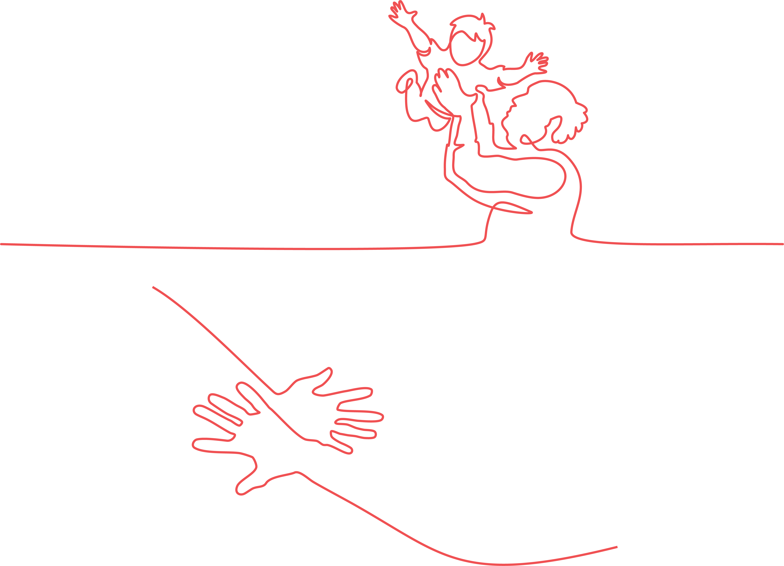
What is Shingles?
Shingles, also known as herpes zoster, is a disease caused by the reactivation of the varicella-zoster virus, better known as chickenpox. When an individual is infected with chickenpox, often as a young child, the virus remains dormant in the body. ¹ The virus can become reactivated in anyone who has had chickenpox, with the highest burden of the disease in those aged 50 years and older. ²
Is Shingles Contagious?
Yes, shingles can lead to infection amongst those who were never vaccinated against or infected with chickenpox. When exposed to someone with shingles, these individuals can develop chickenpox. The virus is spread through direct contact with the fluid that is contained in shingles blisters or the small particles in the air. ¹

Slide 4
What Can I Do if I Have Symptoms of Shingles?
What are the Symptoms of Shingles?
Early symptoms of shingles include skin sensitivity, tingling, itching, or pain. This is then frequently followed by a rash. If you present with these early symptoms you can go to health care provider to request a prescription to antivirals, which can minimize the impact that shingles has on your health. These medications work most effectively if taken within 3 days of a rash appearing. ⁴
Symptoms of shingles include a rash, fever, headache, chills, and upset stomach. ¹ Symptoms last on average between 3 and 5 weeks. ³

Slide 5
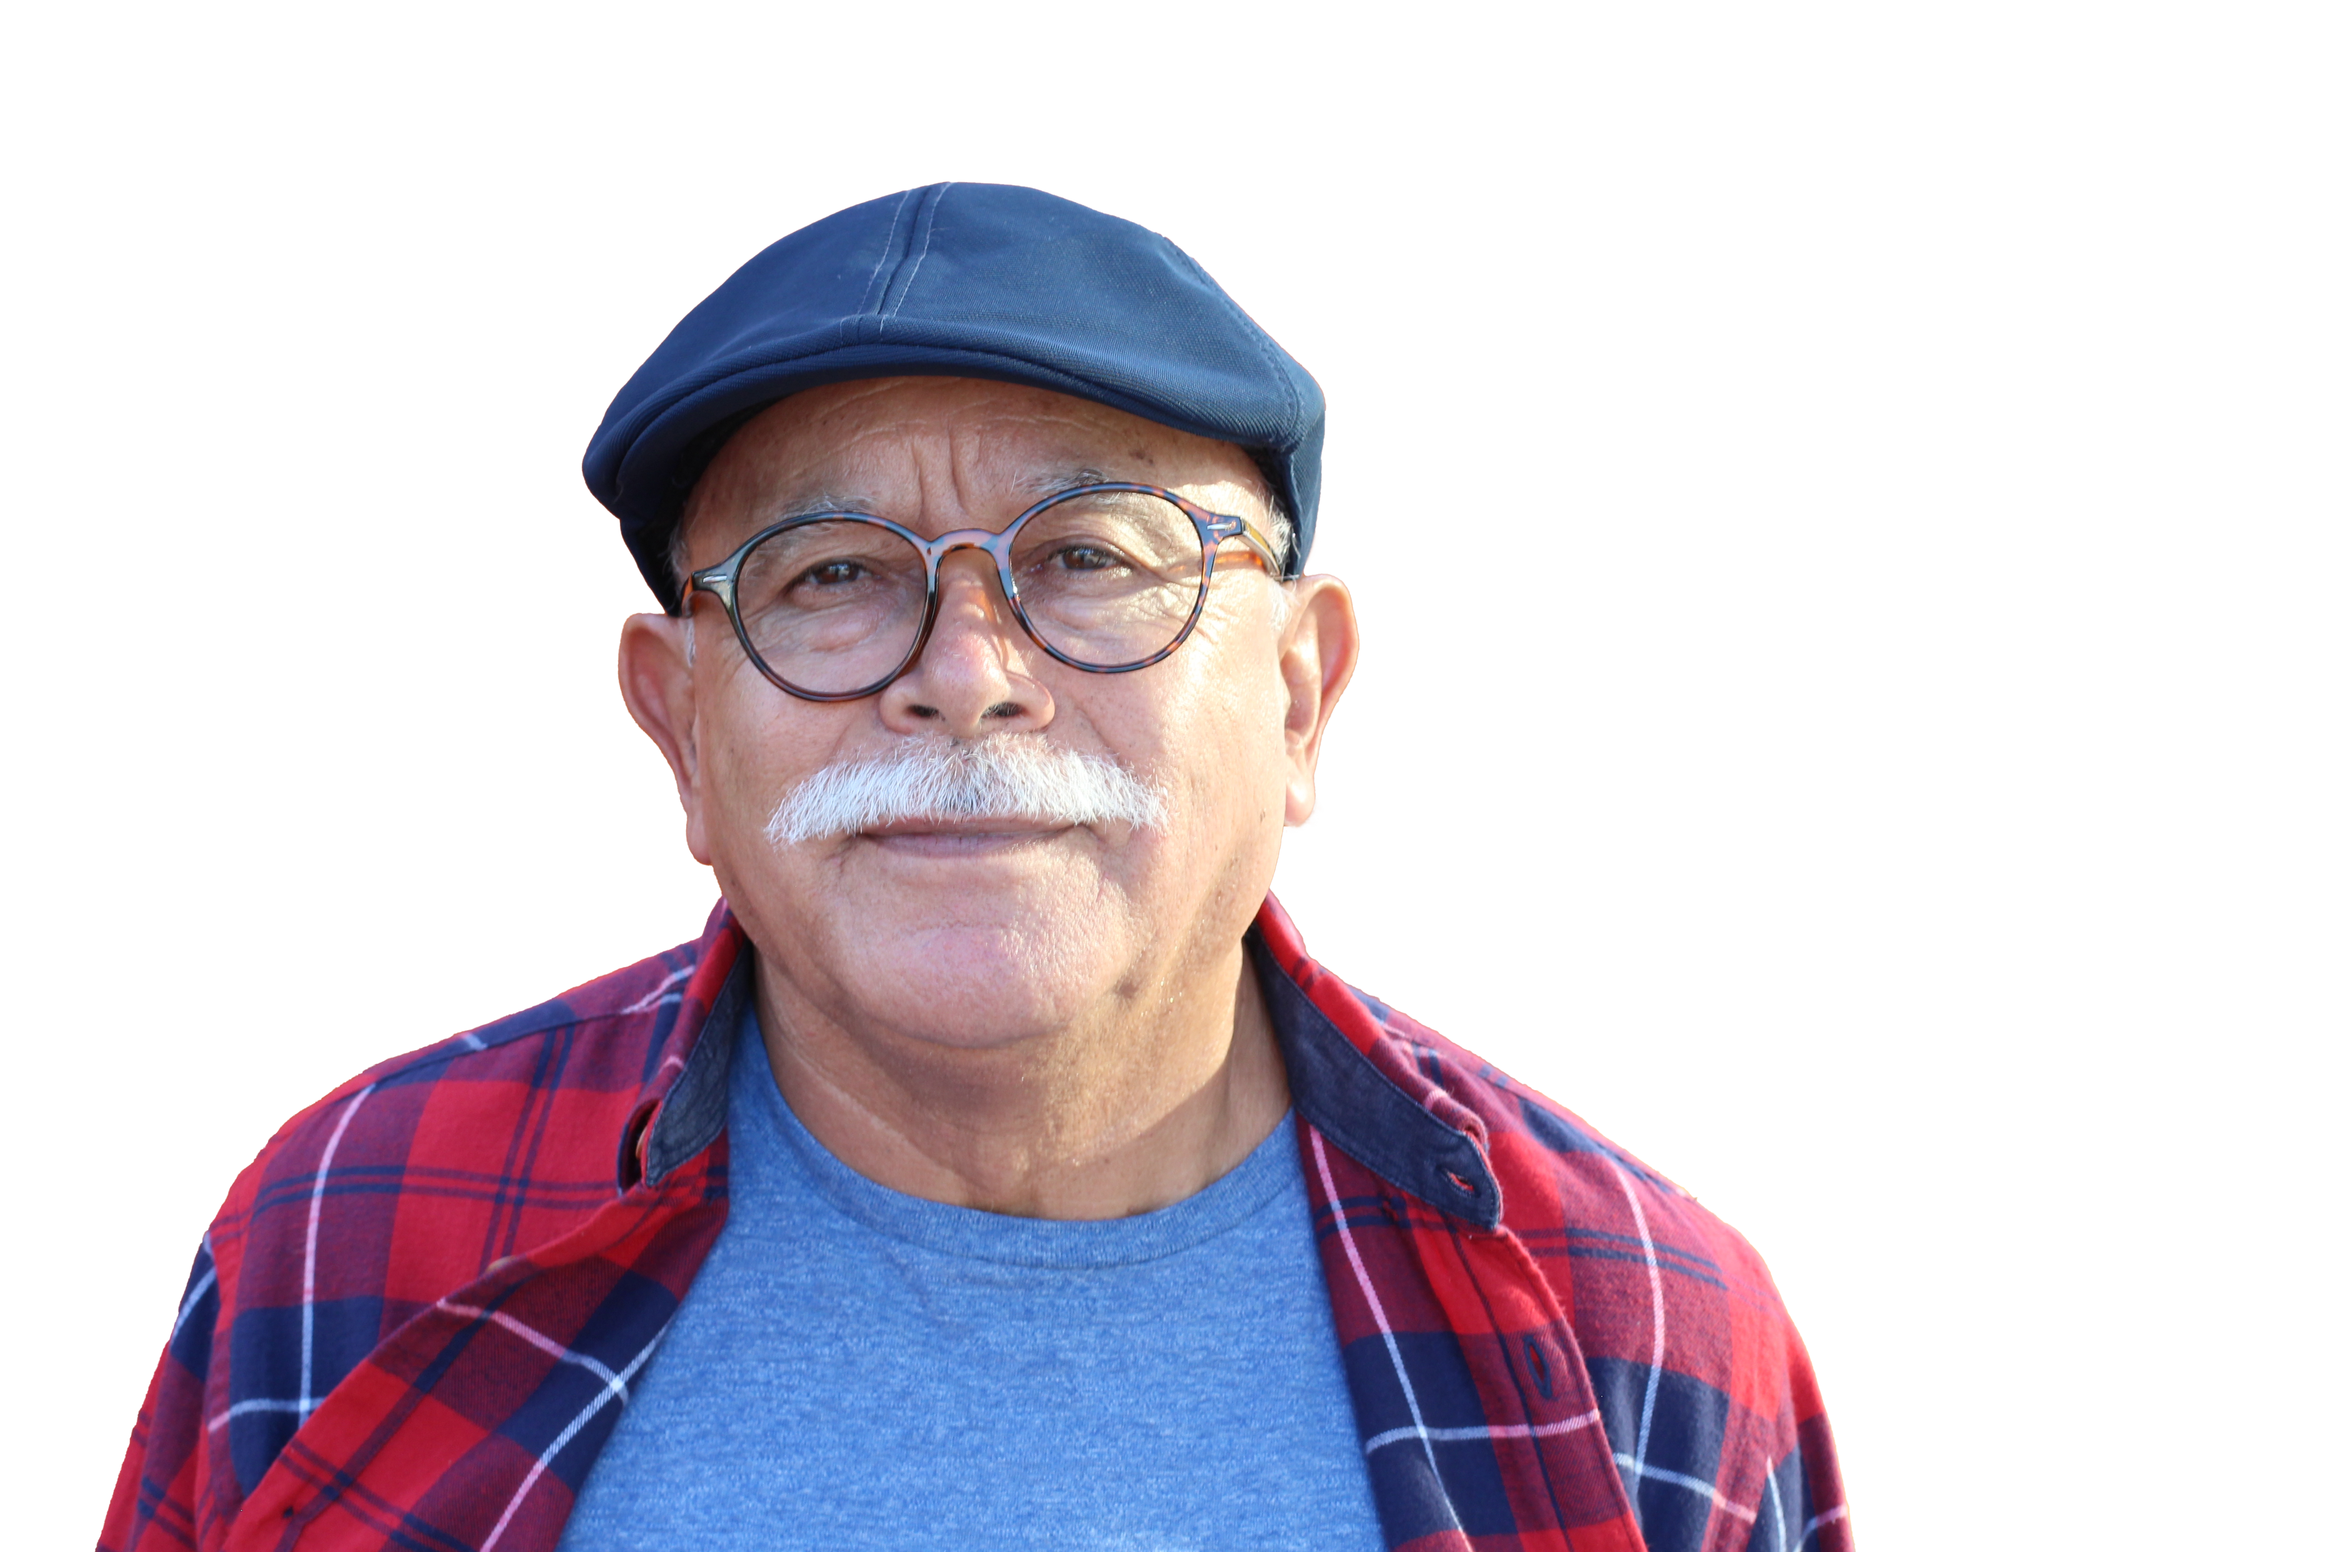
What is the Impact of Shingles in Canada?
Are there Lasting Consequences to Infection?
Nearly one in three Canadians will develop shingles in their lifetime, with the severity of illness increasing with age. Each year in Canada there are approximately 130,000 new cases of shingles, with 20 deaths on average reported as a consequence of shingles infection. ²
As the shingles rash can occur on the face, in some cases this can lead to vision or hearing loss. Other potential side effects of shingles include bacterial skin infections from open wounds created by the rash and postherpetic neuralgia – lasting pain in the areas of the skin where the shingles rash occurred. This pain occurs in approximately one in five people with shingles and can last several years. ¹

Slide 6
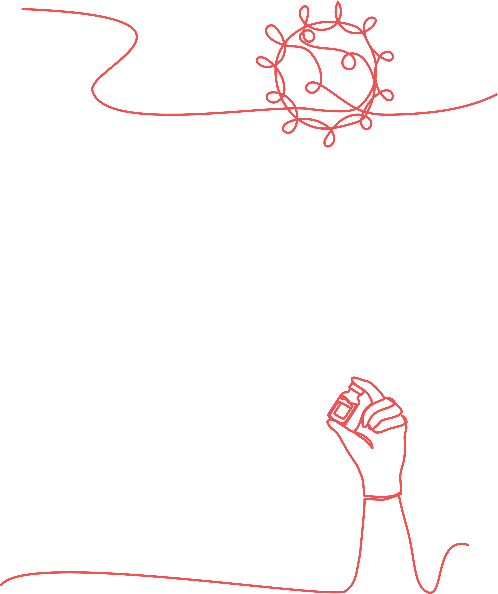
Why are Older Persons Identified as being Especially Vulnerable to Shingles?
How to Protect Yourself
As individuals age the waning of their immune system can prevent a robust immune-response to the dormant varicella zoster virus, making older persons and those with decreased immunity at increased risk for shingles. ^{5–7}
The most effective action to protect yourself against shingles is vaccination. If you believe you may have shingles seek healthcare services to confirm diagnosis and access rapid treatment. ²

Slide 7
Who Should be Vaccinated?
The National Advisory Committee on Immunization (NACI) (Canada) recommends that all adults aged 50 years old and above without contraindications are vaccinated against shingles along with immunocompromised adults under the age of 50 per guidance from a medical professional. ² It’s important to note that you can have shingles more than once, meaning that vaccination is recommended for all those at risk. ²
Evidence is emerging that infection with COVID-19 can also lead to an elevated risk of shingles, demonstrating the importance of being vaccinated against additional vaccine preventable diseases. ⁷
Where can I be Vaccinated?
In Canada each province and territory has different policies regarding funding of shingles vaccination, see here for a breakdown of which provinces fund vaccination against shingles and for whom. ²

Slide 8
How do I Promote Awareness?
Ask those you are close to if they have had chickenpox or shingles and share the information you learned above so that they are aware of the devastating consequences of shingles. Vaccination is a safe and easy way to protect yourself from the potentially lifelong impacts of the disease. The IFA has created a bank of resources in advance of Shingles Awareness Week and encourages you to use these resources to spread knowledge and promote action in response to shingles.

Slide 9
References
1. Prevention C for DC and. Cause and Transmission | CDC [Internet]. 2023 [cited 2024 Jan 17]. Available from: https://www.cdc.gov/shingles/about/transmission.html
2. Government of Canada. Herpes zoster (shingles) vaccine: Canadian Immunization Guide [Internet]. 2023 [cited 2024 Jan 17]. Available from: https://www.canada.ca/en/public-health/services/publications/healthy-living/canadian-immunization-guide-part-4-active-vaccines/page-8-herpes-zoster-(shingles)-vaccine.html#a2
3. Shingles | Johns Hopkins Medicine [Internet]. [cited 2024 Jan 30]. Available from: https://www.hopkinsmedicine.org/health/conditions-and-diseases/shingles
4. Dooling K, Anderson T. Centers for Disease Control and Prevention. 2023 [cited 2024 Feb 7]. Five Things You Should Know About Shingles. Available from: https://www.cdc.gov/shingles/5-things-you-should-know.html
5. Lang PO, Govind S, Michel JP, Aspinall R, Mitchell WA. Immunosenescence: Implications for vaccination programmes in adults. Maturitas. 2011 Apr 1;68(4):322–30.
6. Allen JC, Toapanta FR, Chen W, Tennant SM. Understanding immunosenescence and its impact on vaccination of older adults. Vaccine [Internet]. 2020 Dec;38(52):8264–72. Available from: https://linkinghub.elsevier.com/retrieve/pii/S0264410X20314262
7. Bhavsar A, Lonnet G, Wang C, Chatzikonstantinidou K, Parikh R, Brabant Y, et al. Increased Risk of Herpes Zoster in Adults ≥50 Years Old Diagnosed With COVID-19 in the United States. Open Forum Infect Dis [Internet]. 2022 May 1;9(5). Available from: https://academic.oup.com/ofid/article/doi/10.1093/ofid/ofac118/6545460

