Slide 1
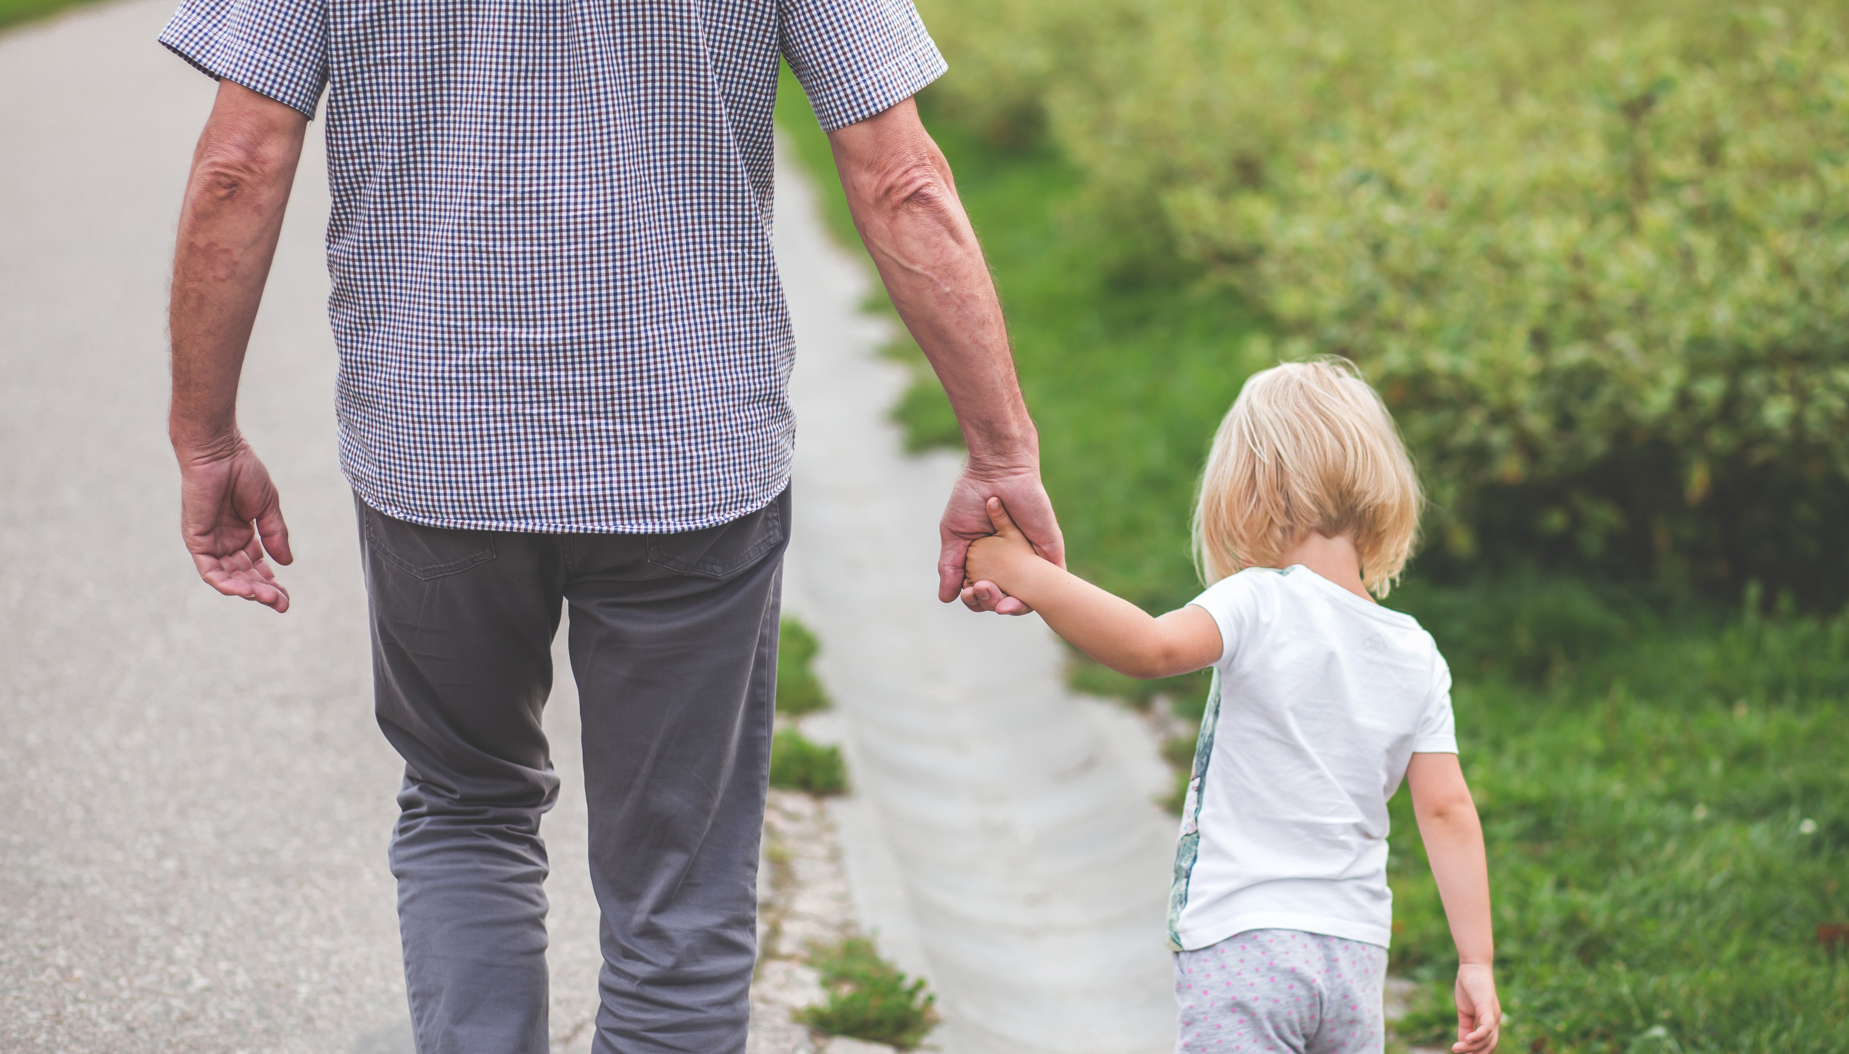

The Adult Vaccination Advocacy Toolkit
(AVAT)
Ms Monica Takahashi
International Federation on Ageing
Notes:
The IFA is located on the Treaty Lands and Territory of the Mississaugas of the Credit and the traditional territory of the Anishinaabe, the Wendat, and the Haudenosaunee.
The territory is within the lands protected by the Dish With One Spoon Wampum Belt Covenant, an agreement between the Haudenosaunee and Anishinaabe and allied nations to peaceably share and care for the resources around the Great Lakes.
Today, the meeting place of Toronto (also known as Tkaronto) is home to many Indigenous people from across Turtle Island, and we are grateful to work on this land.

Slide 2
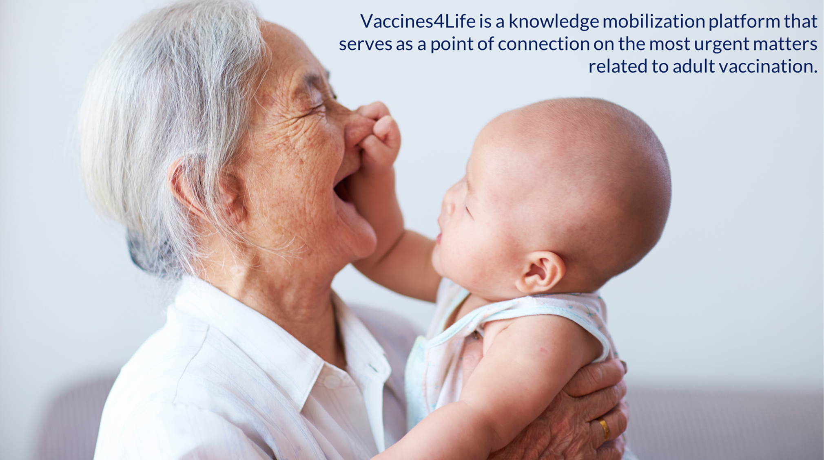

Driving the agenda of the
world’s ageing population
Global point of connection and networks of experts and expertise to influence and shape age-related policy.
A world of healthy older people whose rights to safe and appropriate vaccines are protected and respected through programs that hold high the principles of prevention, access and equity.

Slide 3
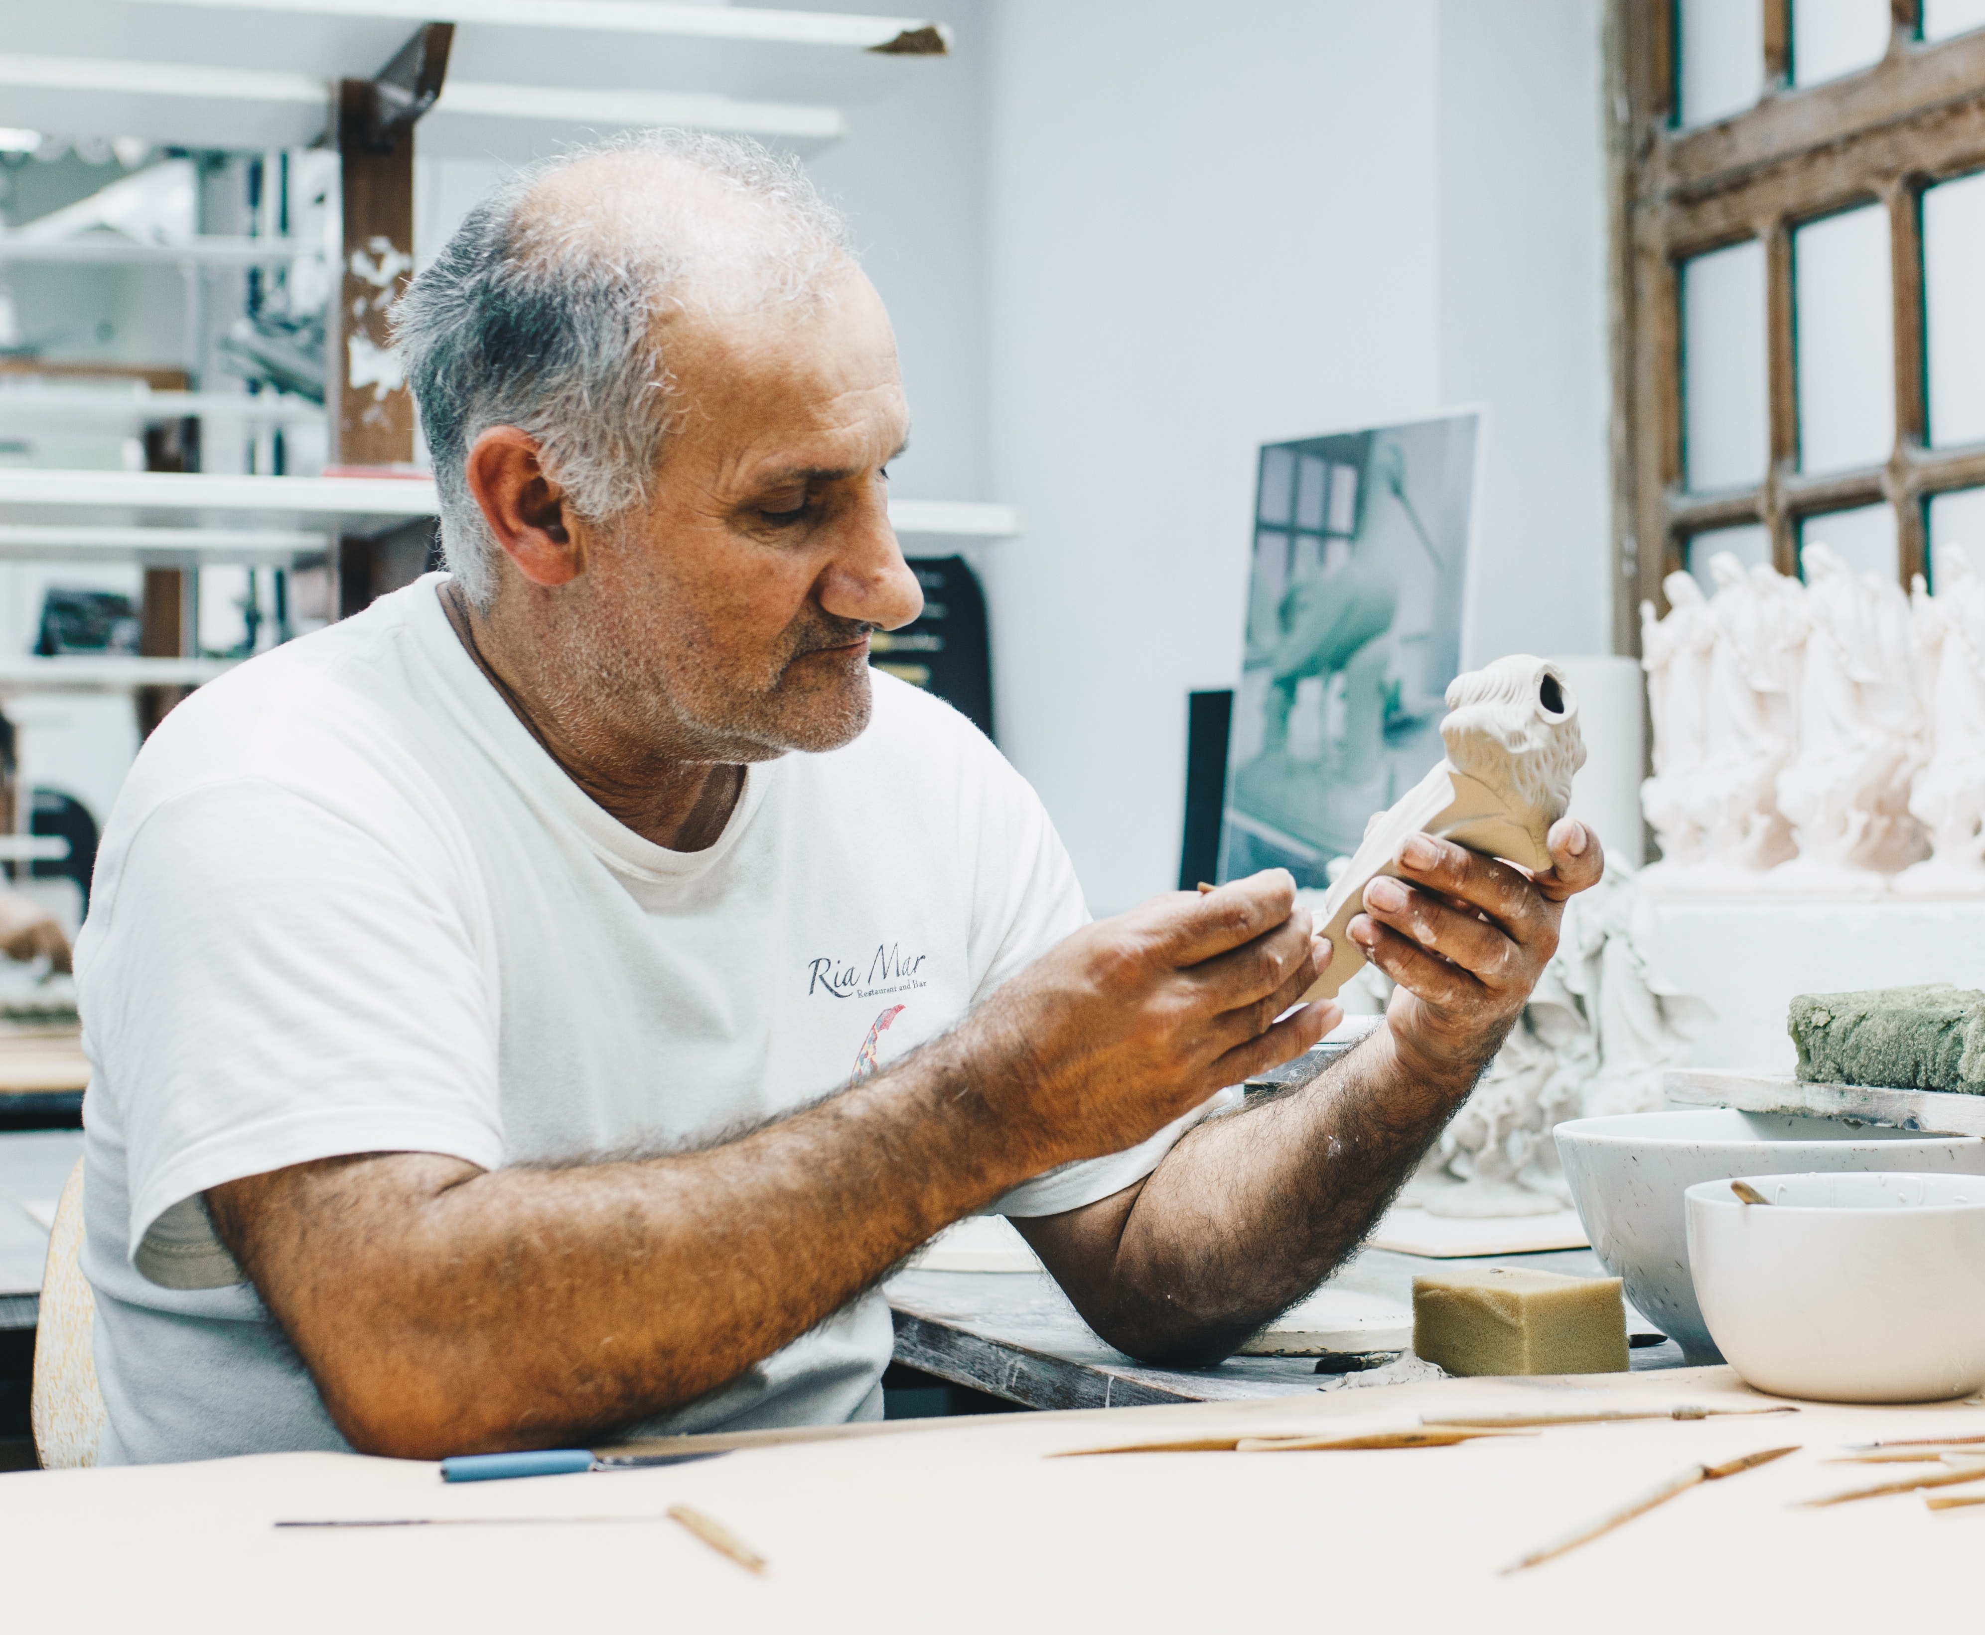
Healthy Ageing
“as the process of developing and maintaining the functional ability that enables wellbeing in older age”

Slide 4

A global collaboration, aligned with the last ten years of the SDGs that brings together governments, civil society, international agencies, professionals, academia, the media, and the private sector to improve the lives of older people, their families, and the communities in which they live.

Slide 5
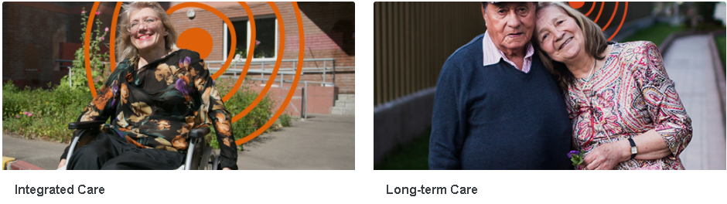
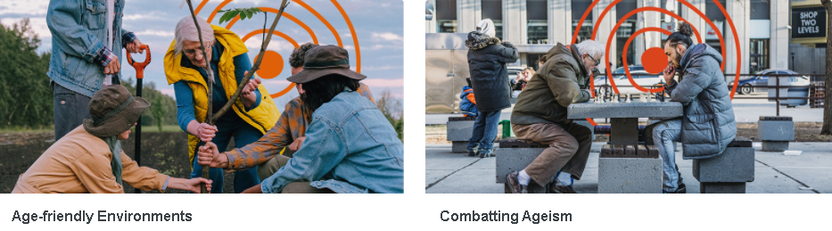
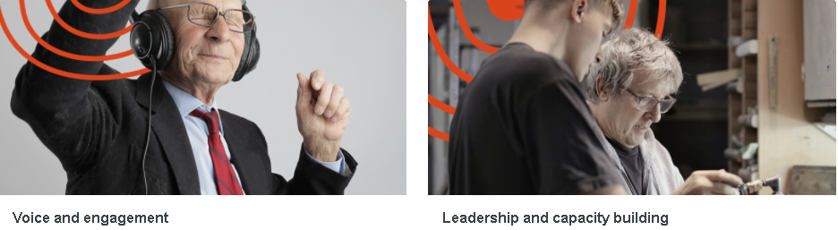

Decade Action Areas
Integrated Care Long-term Care
Age-friendly Environments Combatting Ageism
Decade Enablers
Voice and engagement Leadership and capacity building
Connecting stakeholders Strengthening research, data and innovation
https://www.who.int/initiatives/decade-of-healthy-ageing
Notes:
To foster healthy ageing and improve the lives of older people and their families and communities, fundamental shifts will be required not only in the actions we take but in how we think about age and ageing.
The Decade will address four areas for action:
The UN Decade of Healthy Ageing requires a whole-of-government and whole-of-society response. An online knowledge exchange Platform has been established to connect and convene the stakeholders who promote the four action areas at country level and to support those seeking to find and share knowledge that can improve the lives of older people, their families and communities.

Slide 6
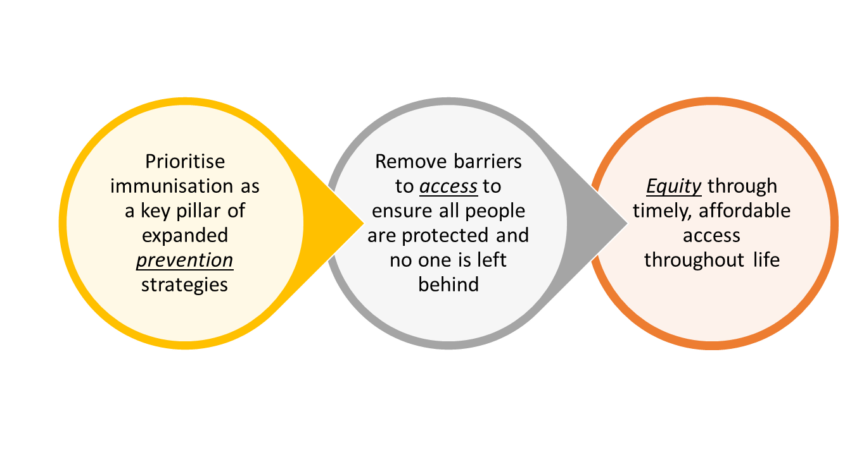

Immunisation For All Ages
Pathways to improve uptake rates of adult vaccination

Slide 7
The Problem
Vaccines are an effective public health intervention
Adult Vaccination rates globally are sub-optimal
Evidence-based tools to influence and shape policy
Notes:
Vaccination is widely accepted to combat routine infectious diseases, such as influenza, pneumococcal pneumonia, pertussis, and shingles for adults and those with chronic health conditions
Yet, there is a discrepancy between this acceptance and the data that has been collected, which shows suboptimal vaccination uptake rates
Apart from a few CSOs, must patient and ageing organizations have not prioritized vaccination until recently. Yes, COVID-19 has been an important lever but CSOs have expressed the need for evidence-based information and guidance to help build their capacity and capability to influence policy and promote the importance of vaccines

Slide 8
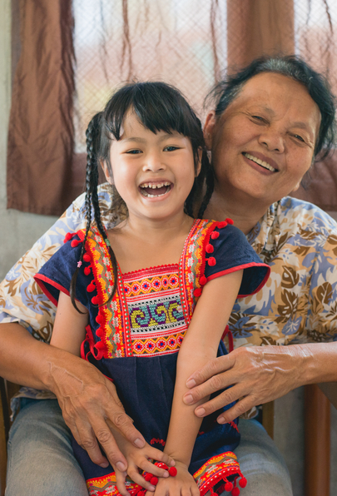
Adult Vaccination Advocacy Toolkit
4 key policy issues:
  Simplification of vaccination pathways
  Expansion of vaccination administrators
  Targeted vaccination campaigns
  Vaccination equity
Notes:
The Adult Vaccination Advocacy Toolkit (AVAT) is a collection of authoritative and adaptable resources.
It is designed to respond to specific barriers for which policies need to be developed or refined to improve uptake rates of adult vaccination at an individual and population-based level.
The AVAT is primarily for civil society, including non-governmental organizations (NGOs), advocacy organizations, professional and community associations, faith-based organizations. However, it will be useful for a range of stakeholders in health promotion, including all levels of government, health care providers, and private sector interests
The toolkit contains four policy drivers that are universally essential for improving adult vaccination coverage:
The Simplification of Vaccine Pathways
Expansion of the Pool of Vaccine Administrators
Effective Targeted Adult Vaccination Campaigns
An Environment that Strives for Vaccination Equity
In the toolkit, each policy issue contains:
Context and scenarios that illustrate the barriers to accessing adult vaccination
Links to useful tools and resources
Actions for advocacy and knowledge assets
Depending on each unique situation, different sections of the AVAT will be more or less relevant. It is the goal of the authors that rather than referring to the entire toolkit, CSOs will be able to jump around the different policy issues to tackle the specific barriers to improving adult vaccination uptake that they are facing.

Slide 9
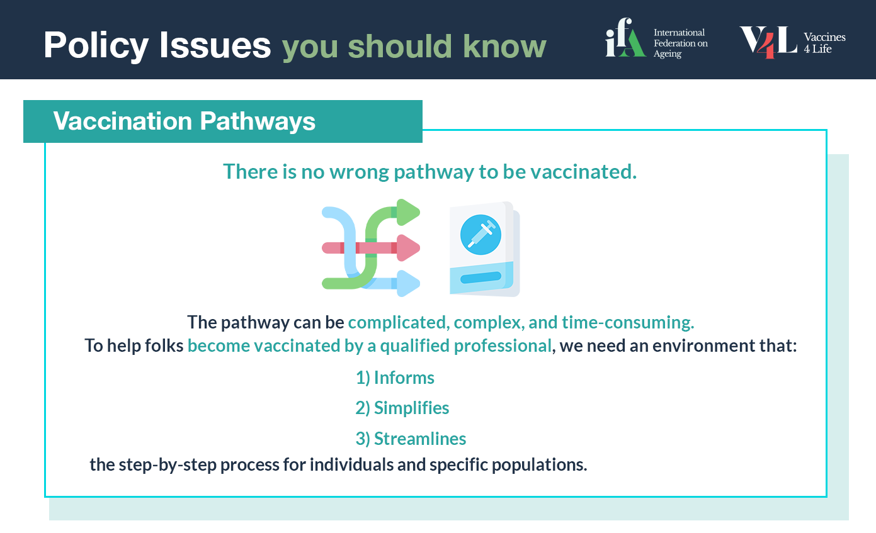
Simplification of Vaccine Pathways
9 / INTERNATIONAL FEDERATION ON AGEING
Notes:
There is no wrong pathway to vaccination. We must 1) inform, 2) simplify, and 3) streamline the step-by-step process for an individual and a specific population to be vaccinated.

Slide 10
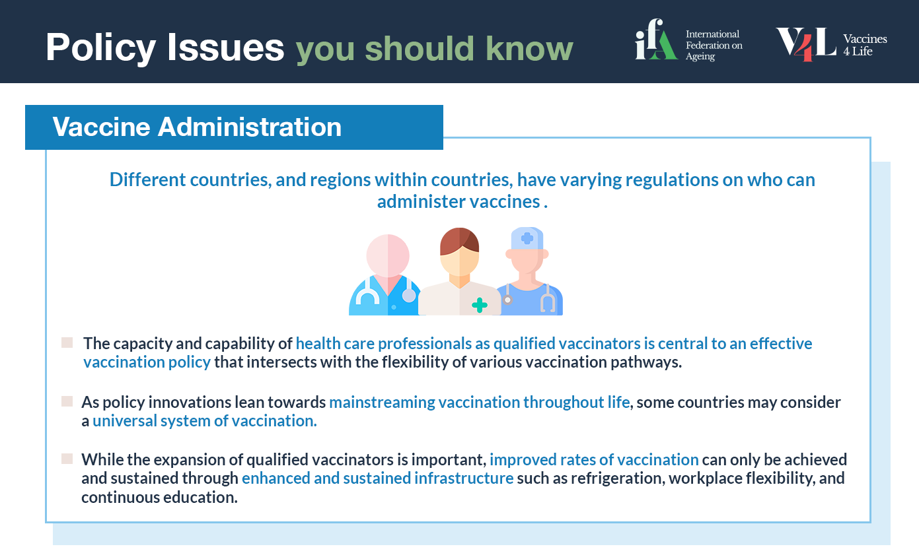
Expansion of the Pool of Vaccine Administrators
Notes:
An important component of any national immunisation plan is an adequate supply of qualified vaccinators according to the nature and density of the population.

Slide 11
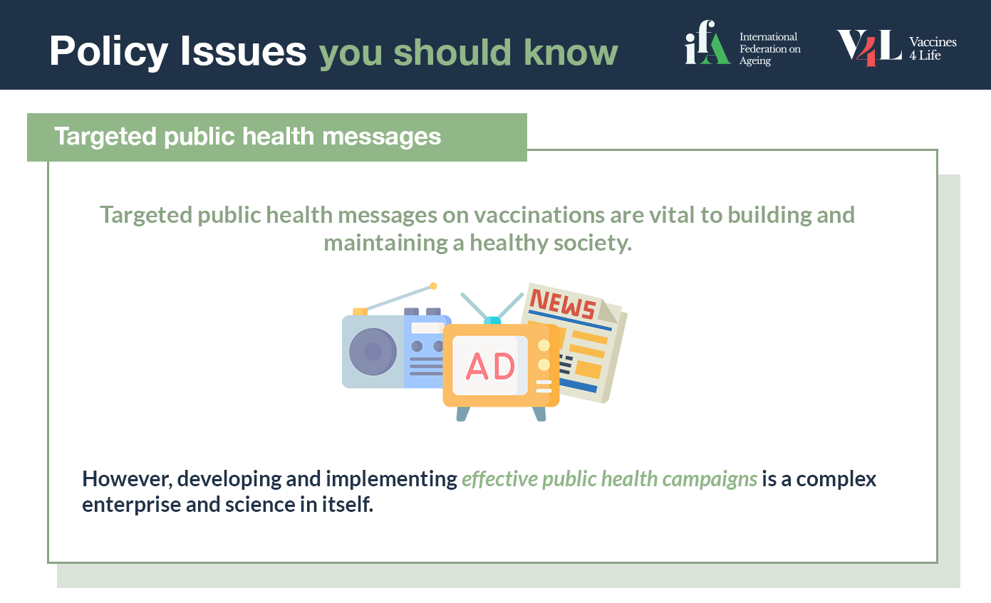
Targeted Adult Vaccination Campaigns
Notes:
Targeted public health messages on vaccinations are vital to building and maintaining a healthy society.
Vaccination programs tend to focus on reducing mortality and morbidity in children even though the major burden of vaccine-preventable deaths is in adults, so need to shift this focus towards adults and those with underlying health conditions

Slide 12
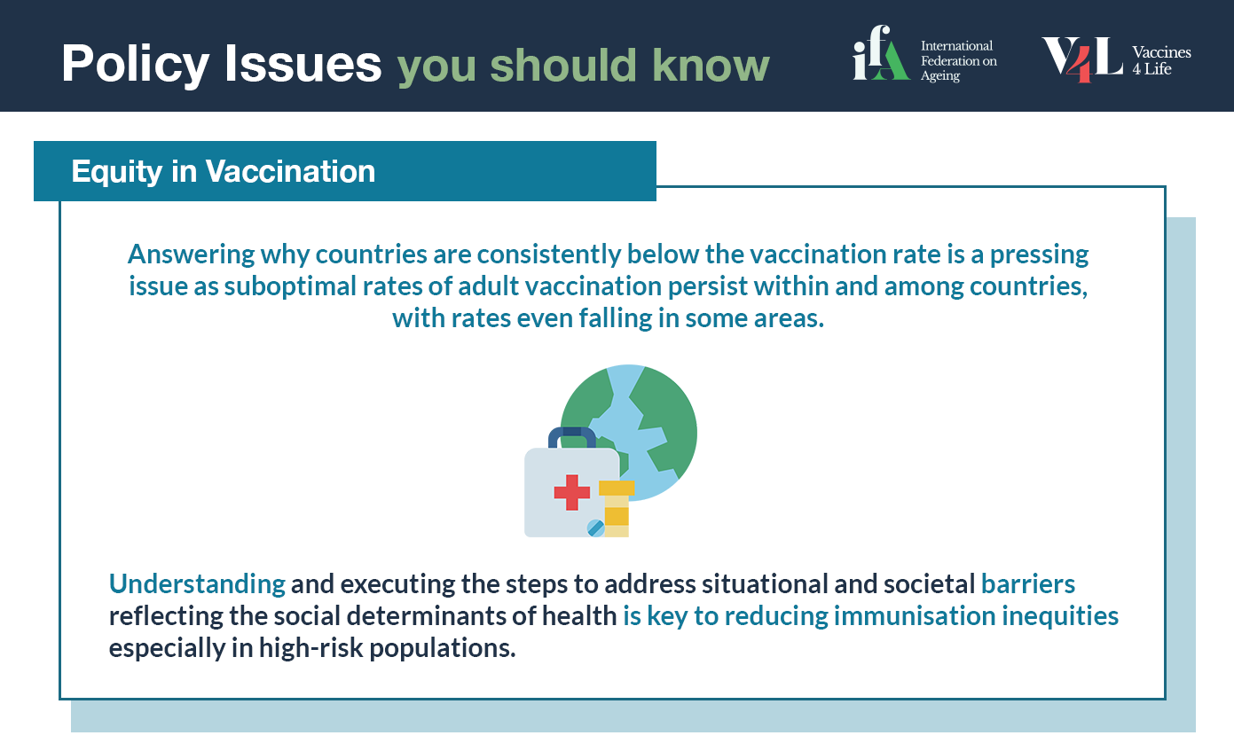
Vaccination Equity
Notes:
In large part, campaigns to inform and encourage older people to be vaccinated overlook the inequity caused through standard universal messages that do not consider the social determinants of health (SDH). Understanding and executing the steps to address situational and societal barriers reflecting the SDH is crucial to reducing immunisation inequities, especially in high-risk populations.

Slide 13
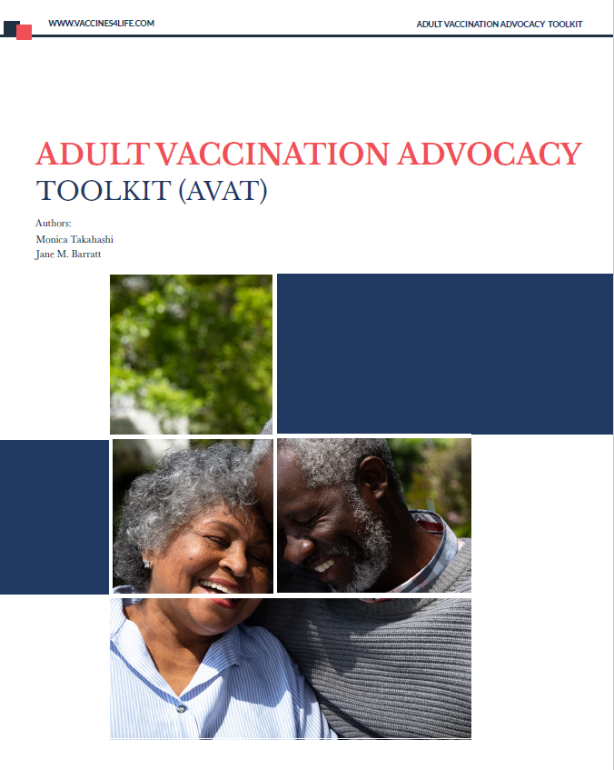
AVATs Next Steps
Notes:
We are in the process of launching this toolkit and it is our intention that this toolkit be widely used and utilized.
We are:
Finalizing the final report, which will be interactive to make it easier to use
Preparing a package, which will include infographics
Gathering a list of CSOs that we believe will find this resource helpful. We will send the AVAT out to this list, but it will also be available on the V4L website

Slide 14
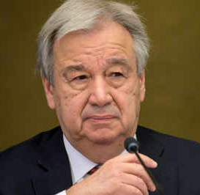
“The potential of older persons is a powerful basis for sustainable development”, Antonio Guterres flagged.
“More than ever, we must listen to their voices, suggestions and ideas to build more inclusive and age friendly societies”.
https://news.un.org/en/story/2020/10/1074362
https://news.un.org/en/story/2021/09/1100152
Notes:
The UN Secretary General
The disproportionate impact of COVID-19 on older people’s health is starting to galvanise communities, civil society and others. We have an opportunity to join forces across sectors and disciplines and with WHO so that the rights of older people (and others at high risk) are met, and their resilience is central to messages from WHO to member states.
The resilience of older people is critical in the process of healing and recovering – as shown in multiple previous crisis and emergency situations. Older people can see the light at the end of the tunnel.

Slide 15
contact Monica Takahashi at mtakahashi@ifa.ngo
For more information on the AVAT,

