Slide 1
Word Medical Association
Empowering civil society to address policies that constitute barriers for improving adult vaccination rates
28 Mai 2022
Dr. Julia Tainijoki-Seyer
Medical and Advocacy Advisor

Slide 2
World Medical Association
International organization representing 9 million physicians worldwide
Founded 18 September 18th, 1947 in Paris
115 National Medical Associations members in addition to individual associate members
Mission: to ensure
the independence of physicians
the highest possible standard of medical ethics
best medical practice
Acting on behalf of patients and physicians

Slide 3
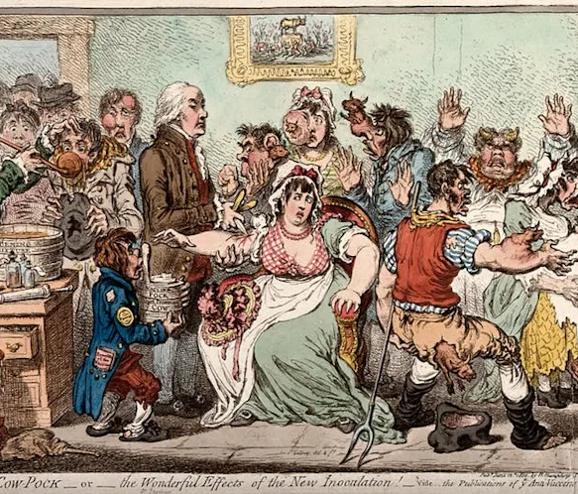
First vaccination- smallpox
1790 Edward Jenner used cow pox, a less serious version to protect against smallpox
Vaccine met with skepticism - it is opposed to God’s will
Fears of putting foreign substances into one’s body
By 1980 small pox was eradicated from Earth
2.5 million deaths prevented per year - from diseases such as diphtheria, tetanus, whooping cough (pertussis) and measles.

Slide 4
How to Improve vaccination rates?
Hesitancy
Access
Awareness
High Income Country
LMIC

Slide 5
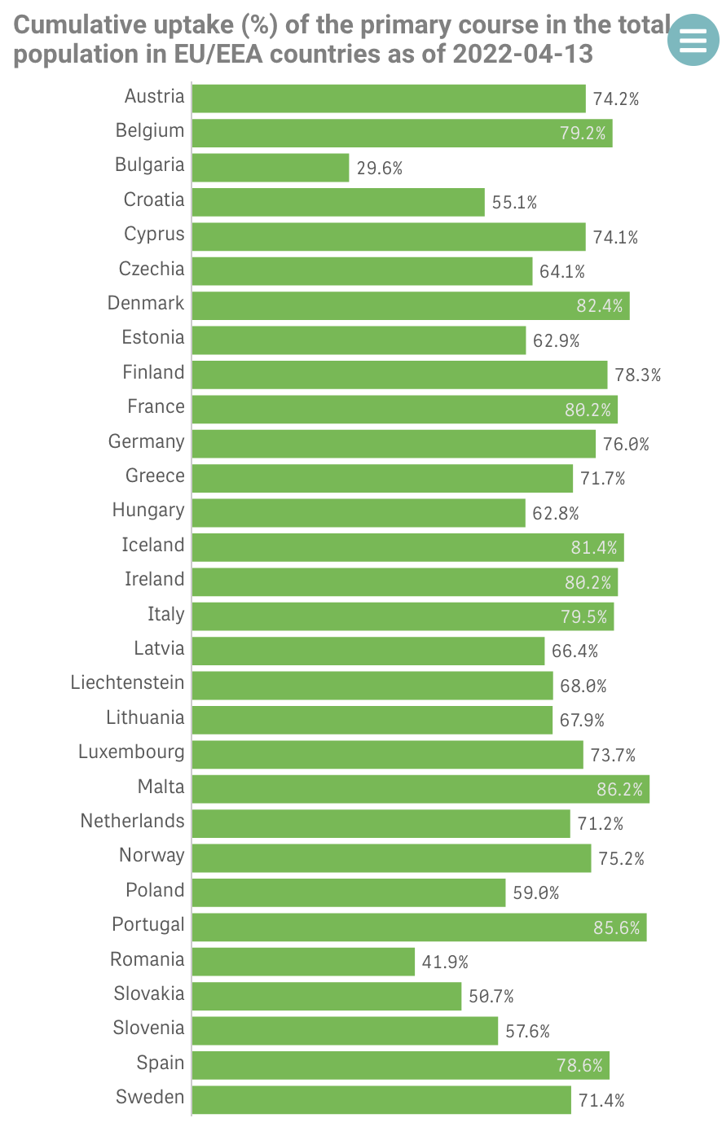
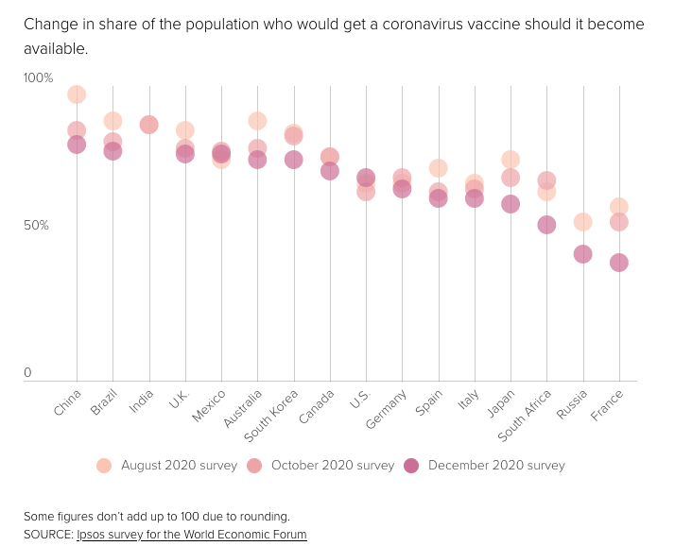
COVID 19 – Vaccine hesitancy
Europe: COVID 19 vaccination rates between 30% - 86%
Data:
European Centre for Disease Prevention and Control

Slide 6
Hesitancy of vaccination
low perception of risk, including the risk of infecting others
fear of possible and perceived side effects from vaccination
questions about the effectiveness of the vaccine; broader anti-vaccine sentiments
misleading reports in the mainstream media and social media, internet and from researchers
a general lack of accurate information about immunization and vaccination
Religious and cultural particularities
emotional, cultural, social, religious, political, cognitive factors

Slide 7
Addressing vaccine hesitancy
The Vaccine Hesitancy Determinants Model (2011), Dubé E., Laberge C., Guay M., Bramadat P., Roy R., Bettinger J.A. Vaccine hesitancy: An overview. Hum. Vaccines Immunother. 2013;9:1763–1773. doi: 10.4161/hv.24657.
Role of HP
Training
Communication and counselling skill
Religious literacy
Medical and epidemiological knowledge
(affective counselling: empathy, active listening, cultural competence, and interpersonal communication)
Counseling
Relation and trust
Educating patients
Recommend vaccination
Leave time for decision to be made
Impartiality – avoiding appearance of conflict of interest
Payment vs time spend counselling
Vaccine delivery service
Relationship of trust and confidence
Continuity of care

Slide 8
Elderly Generation
Multimorbidity – coexistence of 2 or more chronic conditions:
60% for those aged 65-74 years and 80% for those aged ≥85 years ⁽¹⁾
Higher risk of death, disability, poor functional status, poor quality of life, adverse drug events, and other adverse outcomes. ⁽¹⁾
High need for complex clinical care ⁽¹⁾
Higher complication rates at vaccination
Important to see regularly their physician; use vaccination appointment for general check up or vice versa
Continuity of care – high quality of care
1 Multimorbidity in older adults; Marcel E Salive , Epidemiol Rev, 2013;35:75-83. doi: 10.1093/epirev/mxs009. Epub 2013 Jan 31. PMID: 23372025 DOI: 10.1093/epirev/mxs009

Slide 9
Low-income countries
Equitable access to vaccines ⁽¹⁾ :
Receiving the vaccine for the country
Logistics & supply chain
Health care system strengthening
expand storage and cold chain on local level
training the health professionals
Surveillance and monitoring
1) World Bank
Statements from WMA members:
We have other more urgent issues
Vaccine hesitancy is a big issue
Trust in the health care system

Slide 10
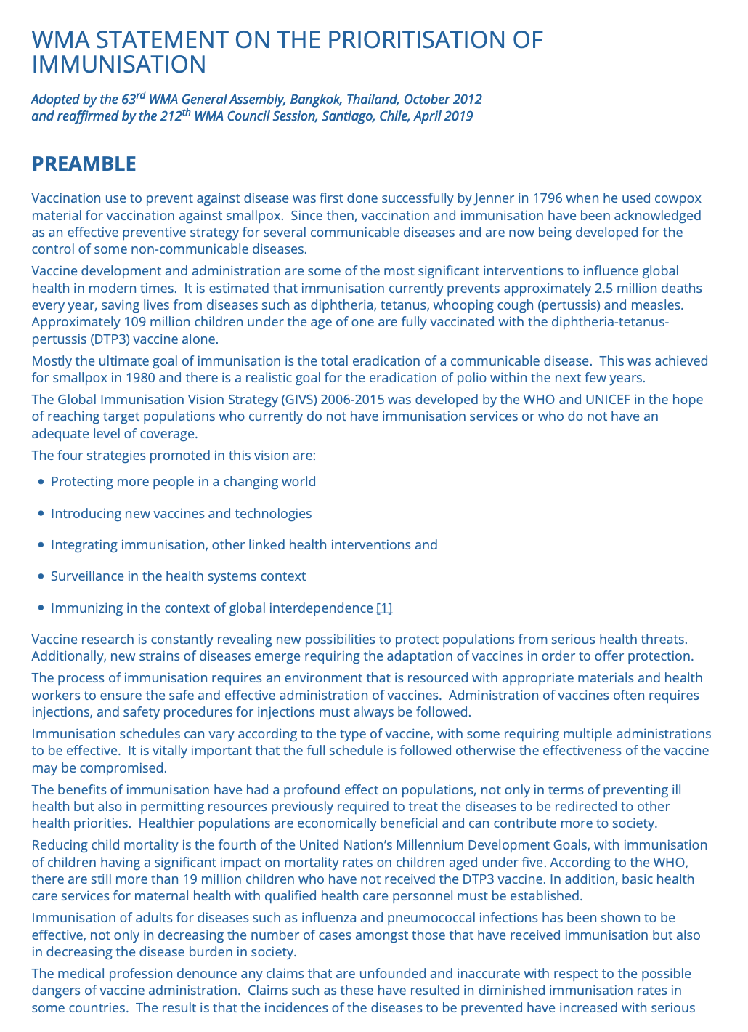
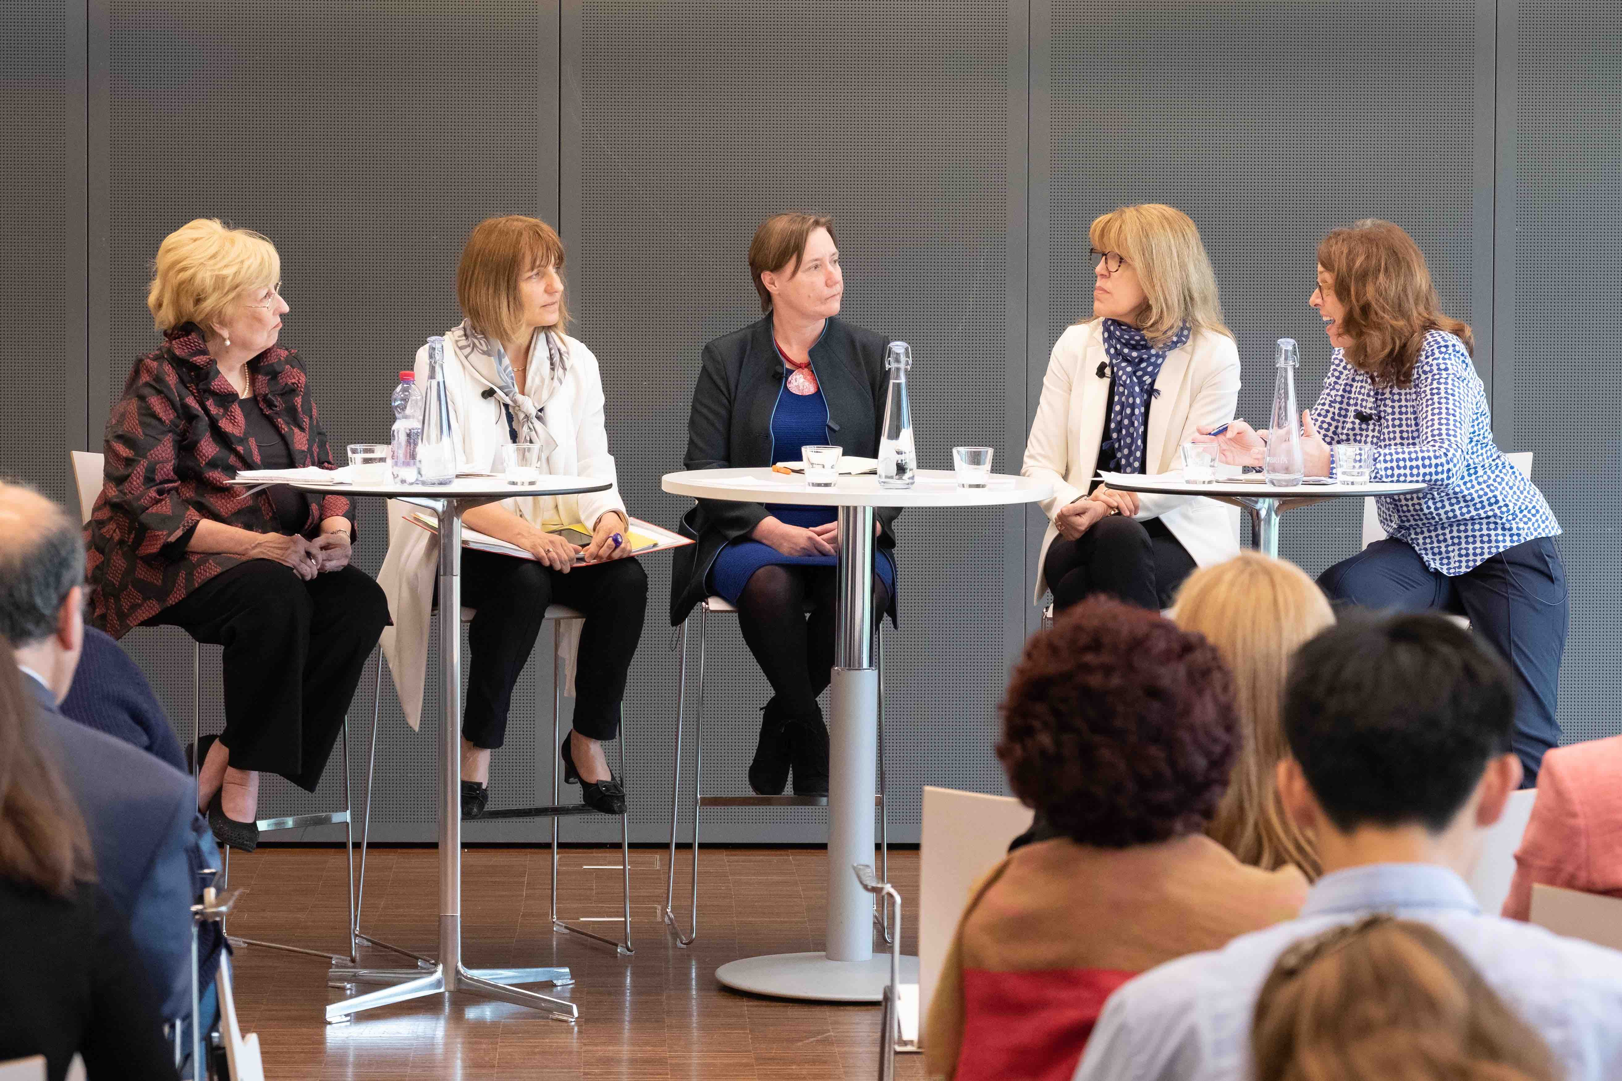
WMA’s activities
WMA Policies on Prioritisation of Immunisation
Conferences
Side events at the WHA
Training
Campaigns

Slide 11
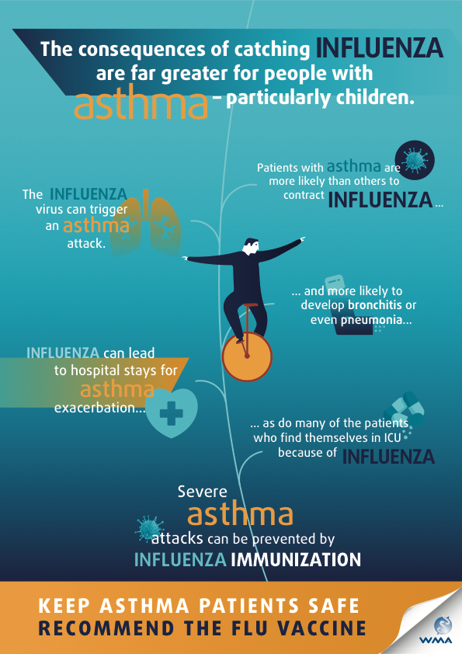
Influenza Campaign Patients with Asthma

Slide 12
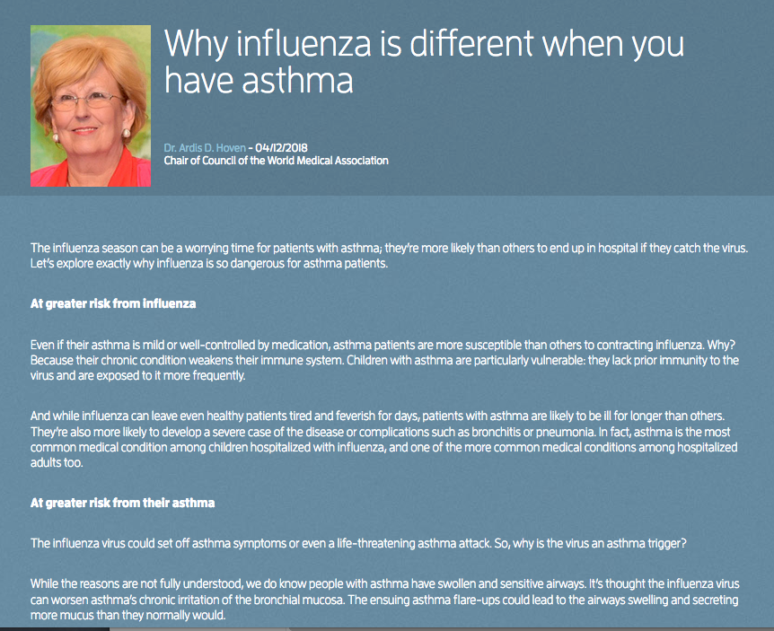
Educational material: blogs and videos
Blogs
Video

Slide 13
Focus: Immunisation of Physicians

Slide 14
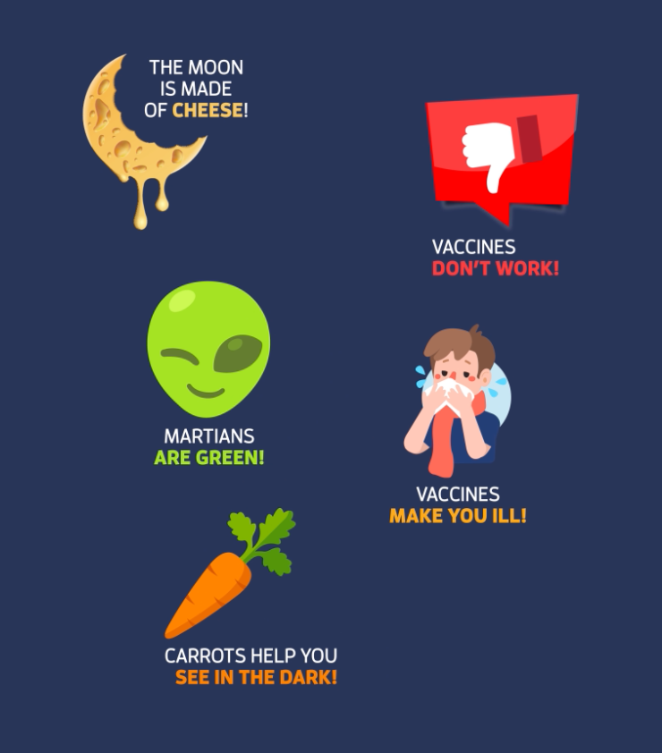
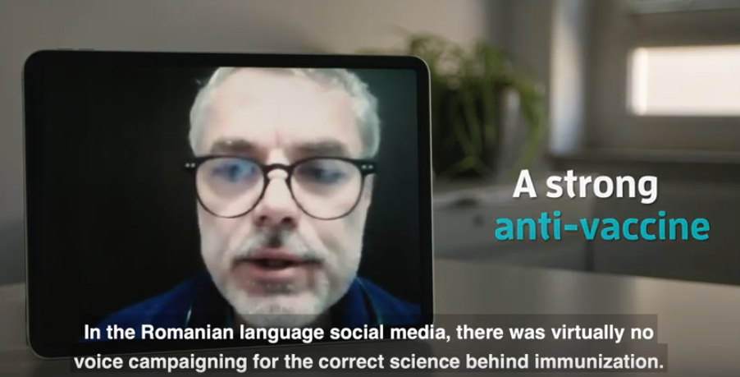
Addressing fake news

Slide 15
WMA members‘ activities
Latvia
President has a weekly TV show and includes regularly influenza immunisation, articles in newspapers and email information to doctors
Taiwan
Developed self-learning materials for physicians
Japan:
Airing TV commercials and providing open lectures for the public
JMA began to launch a signature-collecting campaign to demand the enhancement of routine vaccination
Germany
Press release on importance of influenza immunisation
USA
Article JAMA on hospitalization caused by influenza and immunisation rate
Finland
Article on importance of influenza immunisation and gave several interviews
Korea
Influenza immunisation program focusing on the immunisation of HP in clinics

Slide 16
Summary
Barriers of vaccination: awareness, access and hesitancy
Equitable access in low - income countries
Addressing vaccine hesitancy: building trust and communicate
Elderly people often with multimorbidity - need special care and continuity of care
HP should speak with one voice and work together to increase the uptake of vaccination

